Slide 1
PUBLIC CONSULTATION ON THE DRAFT FLOOD RISK MANAGEMENT PLANS
Office of Public Works
South Dublin County Council // 17th October 2016

Slide 2
FLOOD RISK MANAGEMENT PLANS
Purpose of Presentation
Plan Structure and Content
Recommendations for SDCC
Consultation Process
Scheme Implementation
Notes:
Thanks for opportunity
Presentation take about 15-20 minutes
Followed by Q&A
Feel free to stop me at anytime
Handout of presentation available

Slide 3
Purpose of Presentation
CFRAM Study
Largest study of its kind undertaken in this country
Extensive Survey
Data Collection
Computer Modelling
Consultation
Draft Plans
Road map to manage flood risk in Ireland
Seeking submissions from Councils & Public
Notes:
Thanks for opportunity
Presentation take about 15-20 minutes
Followed by Q&A
Feel free to stop me at anytime
Handout of presentation available

Slide 4
FLOOD RISK MANAGEMENT PLANS
Purpose of Presentation
Plan Structure and Content
Recommendations for SDCC
Consultation Process
Scheme Implementation
Notes:
Thanks for opportunity
Presentation take about 15-20 minutes
Followed by Q&A
Feel free to stop me at anytime
Handout of presentation available

Slide 5
PLAN STRUCTURE & CONTENT
Vol. I - Plan
Vol. II – Flood Maps
Vol. III – Environmental Assessments (SEA, AA)
Notes:
Thanks for opportunity
Presentation take about 15-20 minutes
Followed by Q&A
Feel free to stop me at anytime
Handout of presentation available

Slide 6
PLAN STRUCTURE & CONTENT
Section 4 - Outlines the public / stakeholder consultation and engagement undertaken throughout the National CFRAM Programme and other relevant projects.
Section 5 - Details the existing / potential future flood hazard and risk in areas covered by the Plan
Section 8 - Sets out the options considered for managing flood risk in the area covered by the Plan, and how these were assessed
Section 9 - Provides a summary of the measures proposed in the Draft Plan
Notes:
Thanks for opportunity
Presentation take about 15-20 minutes
Followed by Q&A
Feel free to stop me at anytime
Handout of presentation available

Slide 7
FLOOD RISK MANAGEMENT PLANS
Purpose of Presentation
Plan Structure and Content
Recommendations for SDCC
Consultation Process
Scheme Implementation
Notes:
Thanks for opportunity
Presentation take about 15-20 minutes
Followed by Q&A
Feel free to stop me at anytime
Handout of presentation available

Slide 8
PLAN MEASURES – HIGH LEVEL
Prevention
Sustainable Planning and Development (LAs)
Maintenance of Arterial Drainage Schemes (OPW) / Drainage Districts (LAs)
Land Use Management Measures
Preparedness
Flood Forecasting (OPW/DECLG/Met Eireann)
Emergency Response (LAs, Public, Stakeholders)
Individual and Community Resilience (LAs, Public, Stakeholders)
Data Collection (OPW/EPA/LAs/Others)
Notes:
Thanks for opportunity
Presentation take about 15-20 minutes
Followed by Q&A
Feel free to stop me at anytime
Handout of presentation available

Slide 9
PLAN MEASURES – LOCAL LEVEL
4 Urban Areas Assessed
Very Low Risk in Baldonnel
Options proposed for Lucan to Chapelizod
Camac & Poddle being progressed by SDCC/DCC
Notes:
Thanks for opportunity
Presentation take about 15-20 minutes
Followed by Q&A
Feel free to stop me at anytime
Handout of presentation available

Slide 10
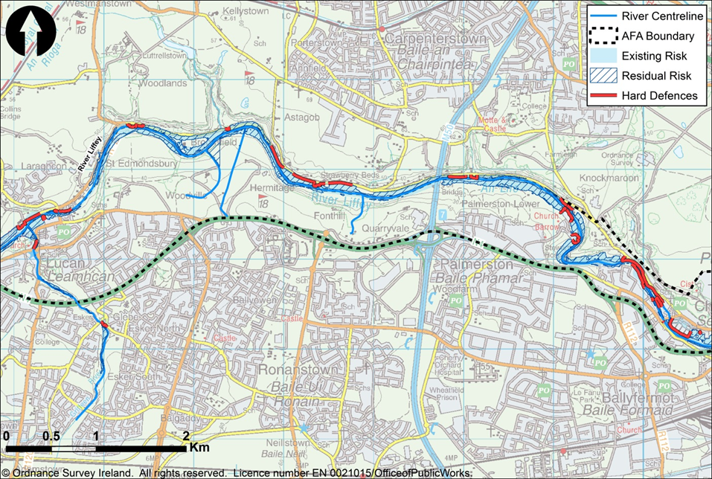
Lucan to Chapelizod – Hard Defences
Notes:
Series of flood embankments and walls. These hard defences would protect to the 1% AEP flood event with an average and maximum height of 1.2m and 2.9m respectively and a total of 3.019km of wall and a total of 2.103km of embankment. The UoM09 Plan and Preliminary Options Report will have further details on the options considered and the assessment process both will be available on-line in due course.

Slide 11
FLOOD RISK MANAGEMENT PLANS
Purpose of Presentation
Plan Structure and Content
Recommendations for SDCC
Consultation Process
Scheme Implementation
Notes:
Thanks for opportunity
Presentation take about 15-20 minutes
Followed by Q&A
Feel free to stop me at anytime
Handout of presentation available

Slide 12
Consultation Process
Project-Level
Eastern Steering Group
Eastern Progress Group
Stakeholder Group
National
National Steering Group
National Stakeholder Group
National Technical Coordination Group
Notes:
Thanks for opportunity
Presentation take about 15-20 minutes
Followed by Q&A
Feel free to stop me at anytime
Handout of presentation available
Consultation throughout the process with input from Fingal Co.Co. engineers at all stages. There’s already been consultation at the flood mapping and options stage where members of the public and the local authority could provide feedback and have their say on the work that’s being done.

Slide 13
DRAFT FLOOD RISK MANAGEMENT PLANS
Completion of Draft Plans
Finalisation of Draft FRMPs
Submit to Minister (DPER) for Approval
Submit to Councils for Adoption
Prioritisation of Measures

Slide 14
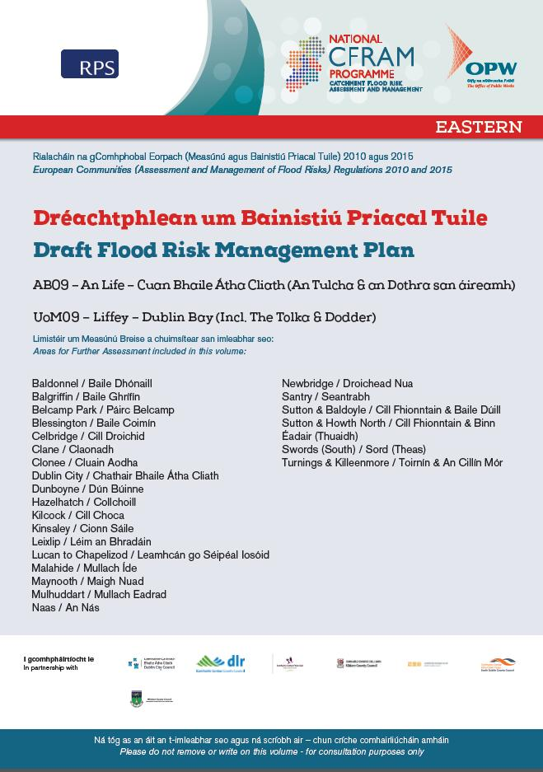
PUBLIC CONSULTATION DAYS
County Library Tallaght
1st November 2016
Lucan Library
2nd November 2016
Notes:
Thanks for opportunity
Presentation take about 15-20 minutes
Followed by Q&A
Feel free to stop me at anytime
Handout of presentation available
PCD’s will be held on the 1st November & 2nd November. OPW & RPS staff will be in attendance to talk people through the plans and making a submission.

Slide 15
PLAN CONSULTATION DEADLINES
PLAN | COUNCIL SUBMISSION DATE | PUBLIC SUBMISSION DATE
UoM 09 | Friday 23rd December 2016 | Friday 2nd December 2016
Note: The Strategic Environmental Assessment (SEA) and Natura Impact Statement (NIS) are also subject to Consultation – (Article 13 of S.I no 435 of 2004)
Notes:
Thanks for opportunity
Presentation take about 15-20 minutes
Followed by Q&A
Feel free to stop me at anytime
Handout of presentation available

Slide 16
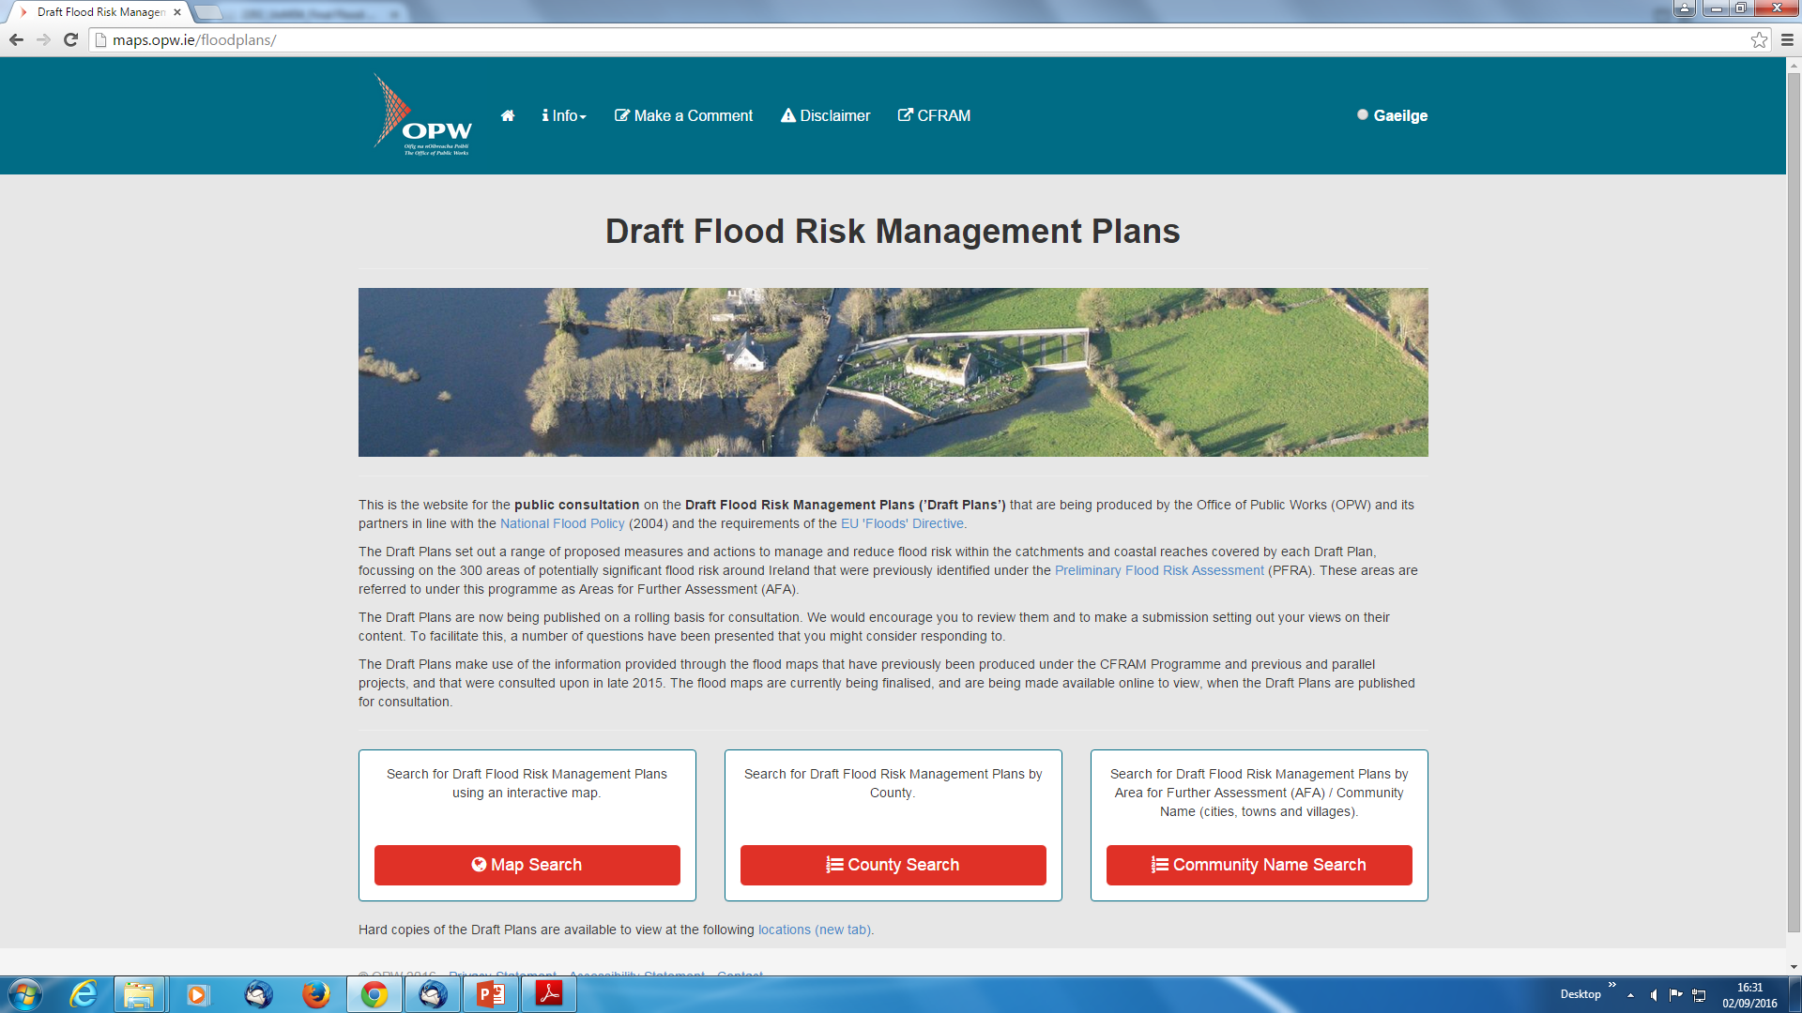
www.opw.ie/floodplans

Slide 17
FLOOD RISK MANAGEMENT PLANS
Purpose of Presentation
Plan Structure and Content
Recommendations for SDCC
Consultation Process
Scheme Implementation
Notes:
Thanks for opportunity
Presentation take about 15-20 minutes
Followed by Q&A
Feel free to stop me at anytime
Handout of presentation available

Slide 18
IMPLEMENTATION
Final FRMPs:
Prioritised National Programme of Measures, Including Responsibility for Implementation and Funding
€430m for Implementation 2016 - 2021
Review of FRMPs - 2021
Notes:
Thanks for opportunity
Presentation take about 15-20 minutes
Followed by Q&A
Feel free to stop me at anytime
Handout of presentation available

Slide 19
Notes:
Thanks for opportunity
Presentation take about 15-20 minutes
Followed by Q&A
Feel free to stop me at anytime
Handout of presentation available

Slide 20
FLOOD RISK MANAGEMENT PLANS
Available to view at:
Local Authority Offices // Www.opw.ie/floodplans
Queries to:
046-942-6039 // DraftPlans@opw.ie
Submissions to:
Draft Flood Plans Consultation, Engineering Services, OPW,
Jonathan Swift St., Trim, Co. Meath, C15 NX36
DraftPlans@opw.ie
Notes:
Thanks for opportunity
Presentation take about 15-20 minutes
Followed by Q&A
Feel free to stop me at anytime
Handout of presentation available

