Slide 1
Parking Permits South Dublin County Council
Land Use Planning & Transportation SPC
29th September 2016

Slide 2
South Dublin County Council – Permits
Resident Parking Permit - €20 per year (Max 2 permits per household)
Visitors Parking Permit - €20 for the first permit and €50 for the second (Max 2 permits per household)
Commercial Permits - €60 per month with the exception of Village Court, Rathfarnham €25 per month to encourage parkers to park away from the busy Main Street, Rathfarnham in this large nearby carpark.

Slide 3
Dublin City Council - permits
Residents Parking Permits - €50 annual permit/€80 for 2 year permit (Max 2 permits per household on newer P&D schemes since 2014)
Visitors Parking Permits - €1.25 each visit sold in pages of 4 (max 160 VPs per annum per household or max 80 for flats/apartments)
Commercial Permits - DCC does not issue commercial permits

Slide 4
Dun Laoghaire-Rathdown County Council - permits
Residents Parking Permits - €40 annual permit/€75 for 2 year permit (Max 4 permits per household)
Visitors Parking Permits - €2 each visit (max 120 VPs per annum per person)
Commercial Permits - DLRCC does not issue commercial permits

Slide 5
Fingal County Council - permits
Residents Parking Permits - €20 per permit for 2 years (Max 4 issued per household)
Visitors Parking Permits - Max 50 discs per person in the household per year at a cost of €12 for 10 discs. You do not have to own a vehicle to apply for these.
Commercial Permits - €600 per business permit

Slide 6
Price Comparison Table
Permit | Residents & Cost | Visitors & Cost | Commerical & Cost
South Dublin County Council | €20 per year | €20 for first €50 for second | €60 per month with exception of Village Court €25 per month
Dublin City Council | €50 per year €80 per 2 year | €1.25 each sold in pages of 4, max 160 per household, 80 per flat/apartment | Does not issue Commerical Permits
Dun Laoghaire-Rathdown County Council | €40 per year €75 per 2 year | €2 each Max 120 per annum per person | Does not issue Commerical Permits
Fingal County Council | €20 per 2 year | €12 for 10 discs Max 50 discs per person per annum | €600 per business permit

Slide 7
New Process for applying for Permits
South Dublin County Council now issue all permits in-house since 17.11.2015
Residents can apply for their permits by hardcopy format or online through the Council’s website at https://goparkit.com/about/location/sdcc/
The online system went live on 26.07.16
Direct assistance provided by Council staff

Slide 8
Permits Issued
Month | Number Issued | Income | Residential | Visitors | Cm | Change of Vehicle | Online Applications
Nov-15 | 13 | € 220.00 | 13 | 0 | 0 | 0
Dec-15 | 47 | € 2,295.00 | 5 | 28 | 13 | 1
Jan-16 | 39 | € 1,825.00 | 10 | 21 | 6 | 2
Feb-16 | 23 | € 580.00 | 7 | 15 | 0 | 1
Mar-16 | 39 | € 2,010.00 | 9 | 22 | 7 | 1
Apr-16 | 59 | € 2,075.00 | 15 | 37 | 7 | 0
May-16 | 46 | € 1,440.00 | 13 | 30 | 2 | 1
Jun-16 | 50 | € 3,540.00 | 9 | 28 | 13 | 0
Jul-16 | 36 | € 1,740.00 | 11 | 22 | 2 | 1
Aug-16 | 26 | € 815.00 | 8 | 16 | 2 | 0 | 4*
 |  |  |  |  |  |  | * system went online on 26.07.2016

Slide 9
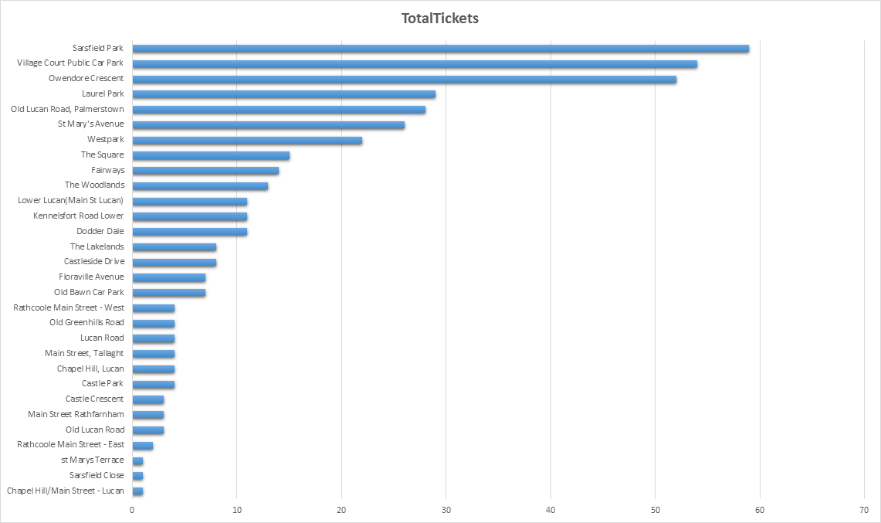
Residential Permits – Top Locations

Slide 10
Commercial Parking Permits – Why?
Parker can pay monthly fee in advance, no need to have coins on a daily basis, saves them having to feed the machine all day
Commercial parking areas are normally away from the busier streets leaving spaces free for customers, achieving higher footfall for traders
Busiest commercial location is Rathfarnham with all commercial parkers parking in Village Court, all these parkers work on Main Street, Rathfarnham
Location | Commercial Permit parking zone
Clondalkin | Castle Crescent
Lucan | Lucan Road (part)
Palmerstown | Old Lucan Road (part) and Kennelsfort Road Upper car park
Rathcoole | Main Street (part)
Rathfarnham | Village Court public car park
Tallaght | Oldbawn Road public car park and Old Greenhills Road
Templeogue | Fortfield Park and Riverside Cottages public car parks

