Slide 1
Development of Rapid Build Project of 85 unit housing project on St. Aidans site, Brookfield Road / R136 Road, Tallaght, Dublin 24, and 5 Traveler Accommodation units on the existing site at St. Aidans site, Brookfield Road, Tallaght, Dublin 24, comprising: • 35 no. 3 bedroom/4 person units - 2 storey • 50 no. 3 bedroom/5 person units - 2 storey • 5 Traveller Accommodation Group Houses The works include: New access off Brookfield Road, landscaping works to boundaries and new park/play area, ancillary works to landscape housing areas, and all necessary associated ancillary works on the site and adjacent areas. The housing provision includes two storey houses primarily grouped in terraces, or semidetached layout.

Slide 2
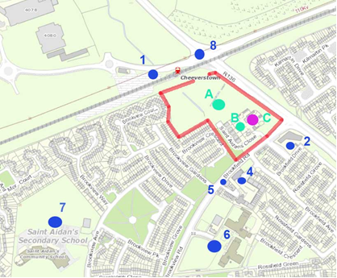
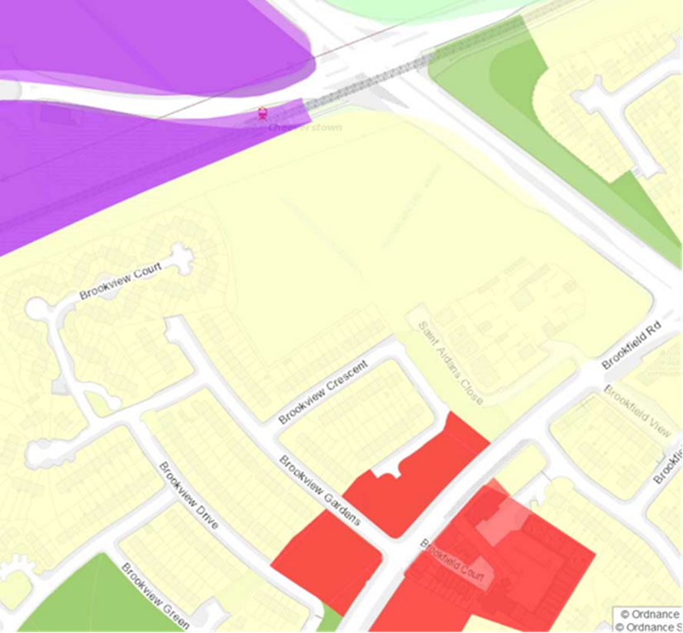

Slide 3
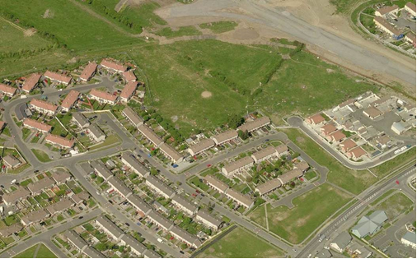
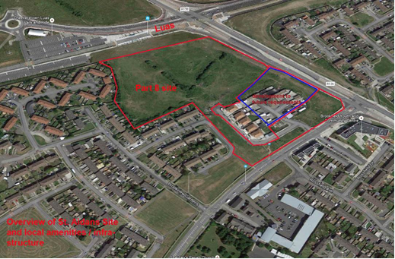

Slide 4
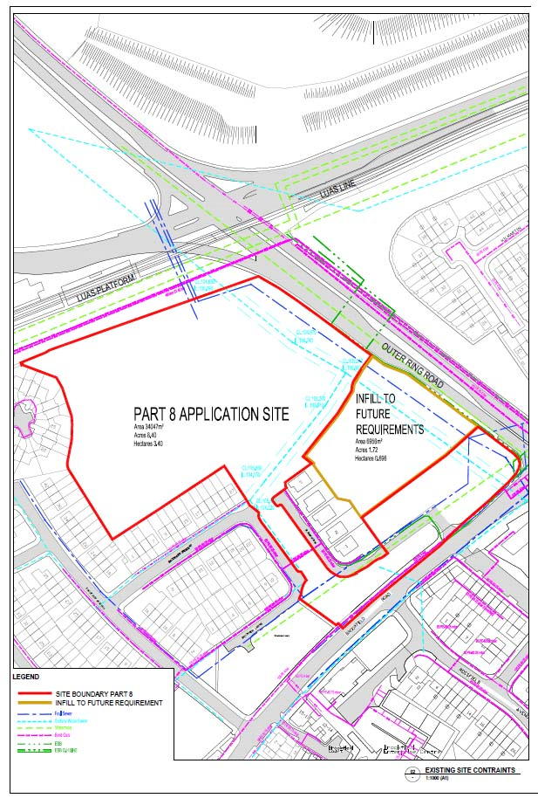
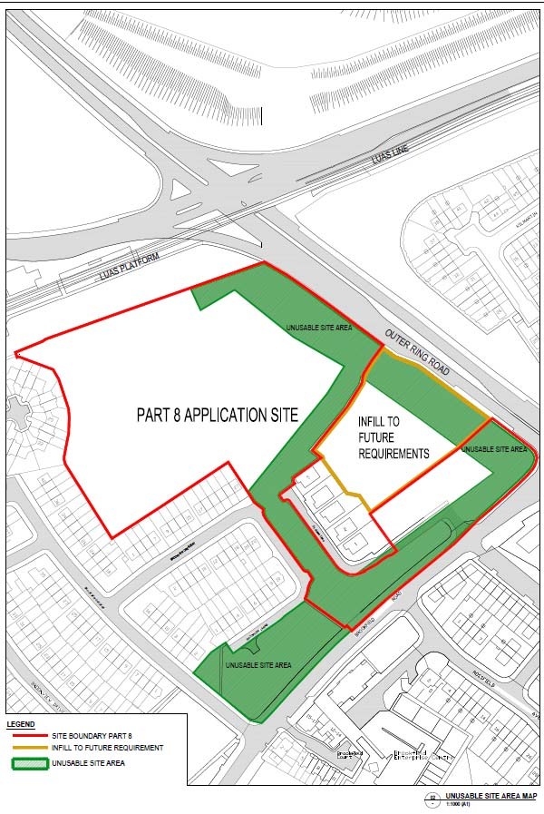

Slide 5
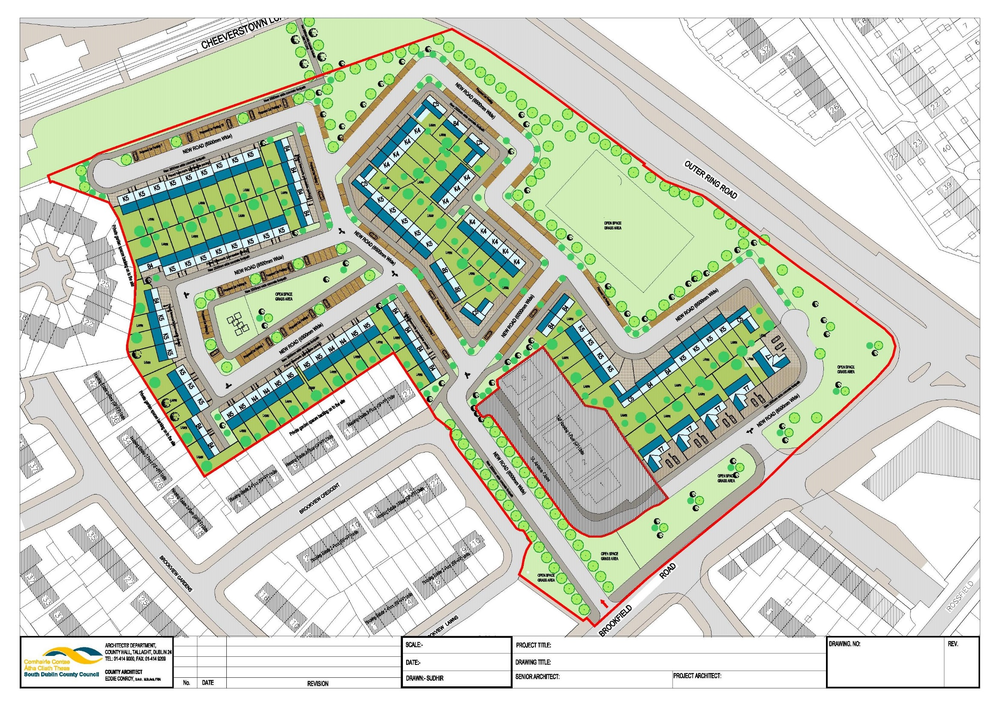

Slide 6
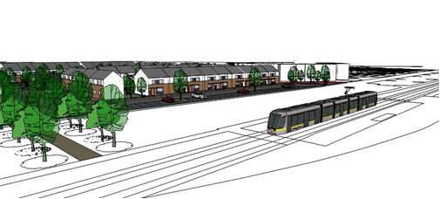
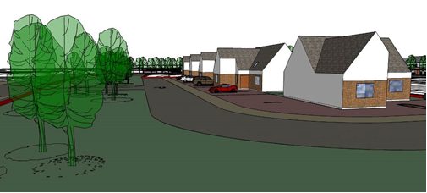
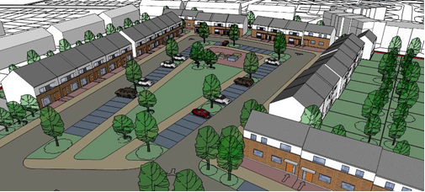
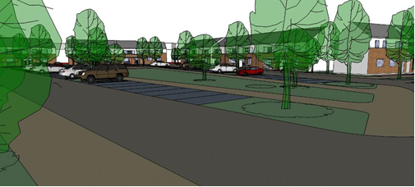

Slide 7
End

Slide 8
