Slide 1
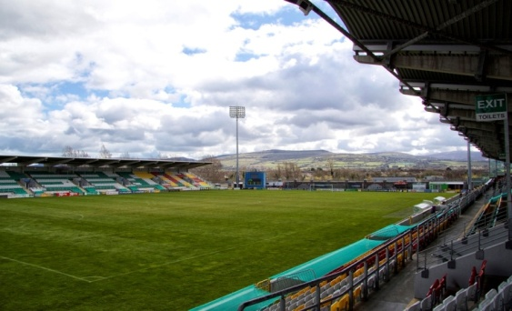
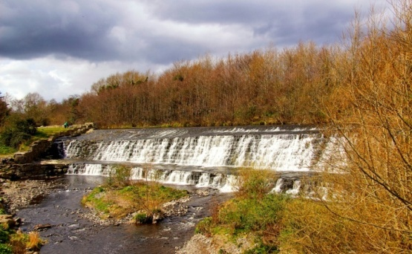
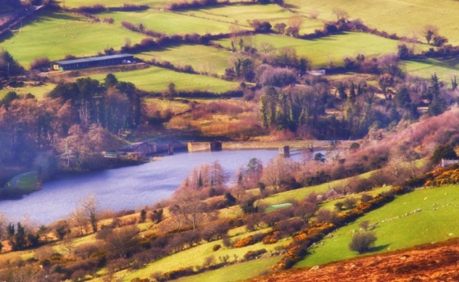
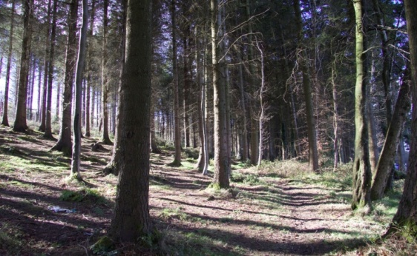
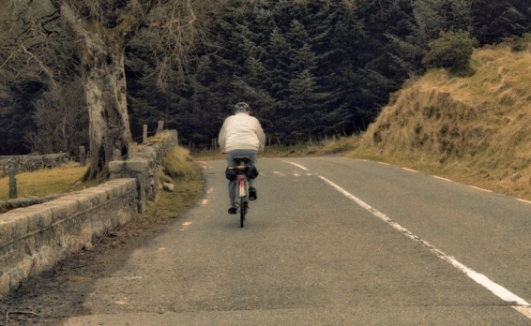
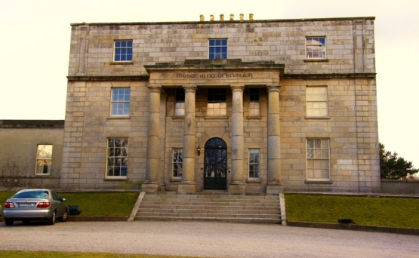
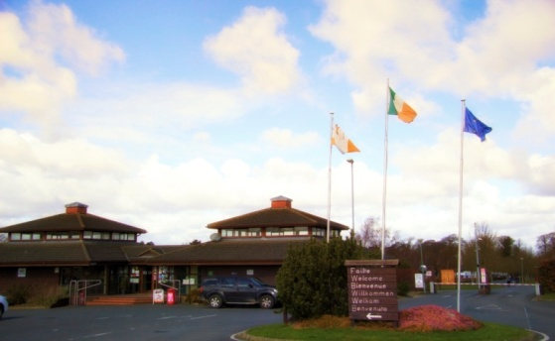
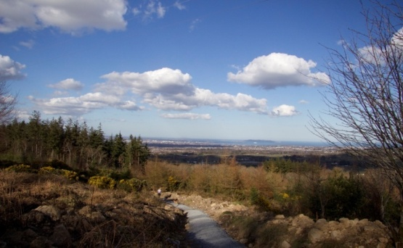
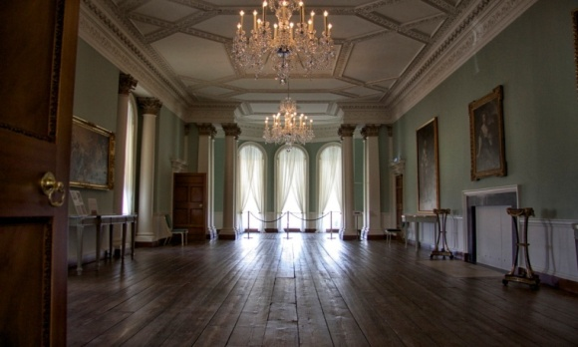
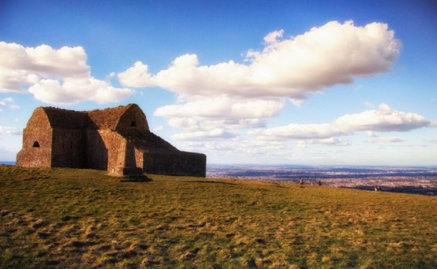
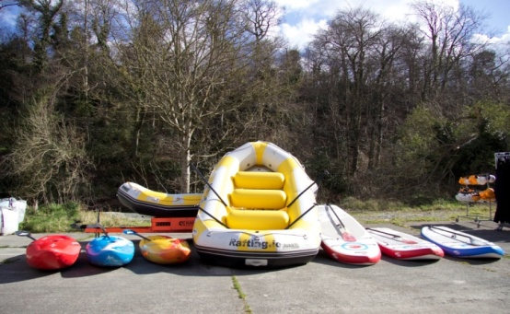
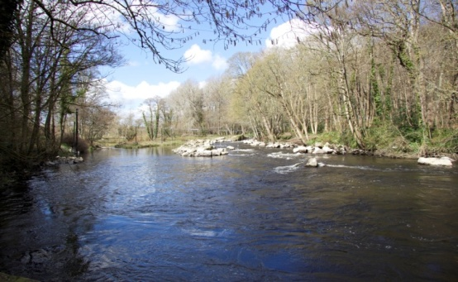
Phase 2 Presentation
Strategy Development
September 2016
Audit | Tax | Advisory
Advisory | Tax | Audit

Slide 2
Project Timeline
Project Initiation
Project End
1 Research and Consult | 2 Create | 3 Campaign Design | 4 Prime/Prepare | 5 Embed and Handover
6 Project Management
Notes:
Reminder of the Project Stages – we are at 2 – Creation of Strategy based on learnings from Stage 1. We would hope to have approval of the overall strategic approach and the 3 key objectives. Allow a week for feedback….

Slide 3
Phase 2: Strategy Development
Develop detailed actionable marketing and branding strategy
Identify SDC’s USPs, brand essence and tagline
Develop key strategic objectives
Identify tourism growth opportunities
Plan for development of marketing collateral
Develop recommendations for supporting events and festivals
Provide added value for Dublin A Breath of Fresh Air
Development of integrated marketing & branding strategy to include:
Marketing goals, objectives and targets
Plan for application of brand identity across all platforms
Definition and profile of target markets and identify communication channels
Schedule of marketing activities
Estimation of resources required
Definition of implementation, monitoring & evaluation techniques
Implementation plan to outline dates, timeframes, responsibilities and milestones
Budget plan to implement the strategy
Recommendations in relation to events and festivals
OBJECTIVES
ACTIVITIES
DELIEVERABLE
Notes:
Activities in this Stage….Select approp channels – tactical approach to reach markets – most effective means…
Resource question – soc media marketing and updating – ITT – Other LAs. Monitoring resource hungry – refining options with CH to have a sustainable monitoring.
We have decided not to do a baseline survey of awareness levels – assumed starting at zero- launch website in 2017 and YOY comparison then on growth – hits, posts, likes etc…
Separate report on Festivals for SDCC – we are reviewing our performance in this space as SPC know – targeting growth of a 2nd flagship festival in Feb 2017.

Slide 4
Marketing Strategy
Marketing strategy document includes:
Tourism trends – understand the marketplace, new developments and help identify target markets
Target markets – agreed initial focus on domestic market: Connected Families & Footloose Socialisers
Brand alignment – need to ensure the strategy aligns with the newly created SDC brand as well as the wider Dublin A Breath of Fresh Air brand
Consultation process – findings from meetings with SDCC, TWG and results from community survey
SWOT analysis – review of current strengths, weaknesses, opportunities and threats for SDC
Marketing strategy consists of :
Strategies
Opportunities
Objectives
Goals
Target markets
Communication channels
Sample key performance indicators
Measurement tracking systems
High-level actions
Notes:
Brand Alignment – consult with FI on any planned activities for domestic markets to ensure consistency of messaging- CH meet Marketing Director as we move to campaign design…

Slide 5
Background to Marketing Strategy
Tender specification
Consultation
Research findings that will influence the marketing strategy and campaigns include:
Increasingly dynamic lifestyles
Practical and inspiring information to motivate choice of 1 place over another
Tourists increasingly travel with a purpose, travel based on “why” not “where”
Immediate and current personalised information, across multiple platforms
Growth of Social + Mobile (SoMo)
Price comparisons are part of the purchase process and visitors seek comparative value for money
Increasing level of user generated content
Shareable moments generate interest and engagement
Notes:
What are the new developments: Dynamic – more people fitter for longer as they age – the outdoors message is not just aimed at high end/high octane – its also a leisure message – need to ensure this isn’t lost in marketing collaterals etc.
The “WHY” is important – not coming to South Dublin, they are coming to the Outdoors – for an experience, not a place.
Tourism very driven by social media referral etc – high premium on quality and frequency of social media marketing – ack’d in other LAs and was T Strategy recommendation…
This research shared with web developer to inform the website….as its very relevant to presentation and communiation of our offering.
Price comparison – Chamber price proposition for hotels – promote this more – capacity and price in City Centre - Chief Exec thoughts with Chamber and CH to build into campaigns

Slide 6
Outline of Marketing Strategy
Draft vision for SDC:
For South Dublin County to become known as a leading destination in which to experience outdoor activities, offering visitors a unique experience that focuses on the county’s natural assets
Agreed in principle from Stage 1 that the strategies should relate to:
Awareness
Collaboration and Cohesion
Campaign Development
Marketing strategy contains high level objectives supported by high level actions
Once strategy is agreed, detailed activities to achieve core marketing objectives is developed in a tactical plan and will include:
Specific marketing campaigns
Responsibilities
Milestones
Budgets
Full plan for Strategy 1 included overleaf, detailed plans for Strategies 2 & 3 included in strategy document
Notes:
Outdoor activities in broadest sense…from low intensity - exploring, walking, trails to higher intensity- cycling, climbing, kayaking, events etc…
3 KEY PRINCIPLES

Slide 7
Strategy 1 - Develop awareness of South Dublin County as a tourism destination (1)
Develop awareness of South Dublin County as a tourism destination
Opportunity: To develop and animate the South Dublin County brand To encourage participation with the brand online and offline across local tourism businesses, the local community and visitors
Objective 1: To develop and promote South Dublin County’s brand, “Dublin’s Great Outdoors” | Objective 2: To ensure that the promotion of “Dublin’s Great Outdoors” aligns with “Dublin A Breath of Fresh Air” | Objective 3: To regularly review the portrayal of the brand and ensure consistent use of the brand across all platforms
Goals: Promote the “Dublin’s Great Outdoors” brand in all marketing campaigns Activate the “Dublin’s Great Outdoors” brand in all marketing campaigns through SDC’s tourism industry Develop a brand toolkit and establish usage rights of the brand Ensure brand awareness across all tourism stakeholders in SDC (support agencies, tourism businesses, tourism related business and the local community) Promote the use of the brand by all tourism stakeholders | Goals: Emphasise the fit between SDC’s brand and tourism product with the DBFA brand and its relevant themes i.e. City of Words, Living Bay, Dublin Stories Hidden and Untold and Extraordinary Days & Happening Nights Avail of DBFA branding, promotional and collateral supports | Goals: Evaluate the use of the “Dublin’s Great Outdoors” brand to ensure it is used consistently across all platforms Evaluate new marketing activities and messaging to ensure that the “Dublin’s Great Outdoors” message is reflected and reinforced Ensure that itineraries are reflective of the brand
Notes:
Just one of the 3 KEY objectives presented in detail, the report contains more..
Some of the objectives are outward looking, some are inward – i.e. require liaison and communication between partners..

Slide 8
Strategy 1 - Develop awareness of South Dublin County as a tourism destination (2)
Develop awareness of South Dublin County as a tourism destination
Target Market (visitor): Domestic: Connected Families, Footloose Socialisers International markets to be targeted at a later stage Target Market (industry): Local tourism businesses SDC Tourism Working Group County Council Fáilte Ireland, including Dublin A Breath of Fresh Air Local community All third party bodies involved in tourism marketing and promotion (ITOA etc | Target Market (industry): Dublin A Breath of Fresh Air SDC Tourism Working Group Crowe Horwath County Council Local tourism businesses All third party bodies involved in tourism marketing and promotion | Target Market (industry): SDC Tourism Working Group Local tourism businesses Fáiilte Ireland including Dublin A Breath of Fresh Air County Council Local community All third party bodies involved in tourism marketing and promotion
Communications Channels: Online: SDC tourism website Tourism Ireland e-marketing, e-zines and social media posts Facebook advertising Twitter account Video YouTube video campaigns Targeted domestic and international PPC campaigns Communication with tourism businesses Industry’s individual websites and social media platforms Online newspapers | Communications Channels: Online: All online channels used in marketing campaigns Offline: Liaison between Crowe Howarth and DBFA Communication to local tourism businesses DBFA training and workshops All offline channels used in marketing campaigns | Communications Channels: Online: Email communication with stakeholders re use and review of consistency All online channels used in marketing campaigns Offline: All offline channels used in marketing campaigns
Notes:
Tactical campaign much more specific will select the sector – the key messages – the timing – the communication channel – the cost – the content – monitoring method….

Slide 9
Strategy 1 - Develop awareness of South Dublin County as a tourism destination (3)
Develop awareness of South Dublin County as a tourism destination
Communications channels: Online: Flyers Bow flags/banners Brochures Display material Industry premises Outdoor advertising TV TBC/finalised once budget is allocated
Sample Key Performance Indicators : Use of brand in marketing campaigns Use of brand in local tourism business campaigns Participation of industry in use of SDC logo Use of SDC logo in media Awareness levels | Sample Key Performance Indicators : Alignment with DBFA brand in SDC marketing campaigns | Sample Key Performance Indicators : Use of brand in SDC marketing campaigns Use of brand in local tourism business campaigns Participation in brand activation Awareness levels
Measurement Tracking Systems: Individual businesses to track and report on usage (via bi-annual questionnaire) Online engagement statistics Awareness survey Media monitoring | Measurement Tracking Systems: Individual businesses to track and report on usage (via bi-annual questionnaire) Online engagement statistics Awareness survey Media monitoring | Measurement Tracking Systems: Individual businesses to track and report on usage (via bi-annual questionnaire) Online engagement statistics Awareness survey Media monitoring
Notes:
Indicators and measurement – strong onus upon engagement by and liaison with the industry…

Slide 10
Strategy 1 - Develop awareness of South Dublin County as a tourism destination (4)
Develop awareness of South Dublin County as a tourism destination
High-level actions: Alignment of brand with SDC tourism website Integrate brand into tactical plan and all campaigns Circulate brand toolkit Introduce brand to local community Develop a tracking system to measure results/performance (implemented by the tourism industry) | High-level actions: Ongoing communication with DBFA to ensure alignment Ongoing communication with DBFA to ensure awareness of and use of available resources and promotion opportunities Attendance at relevant DBFA training and workshops | High-level actions: Create survey for branding review (for circulation by Council to tourism industry for completion) to include review of use and consistency Analysis of findings Communication of findings to industry Review of third party sites

Slide 11
Strategy 2 – Encourage collaboration and cohesion amongst the local tourism industry and key stakeholders
Encourage collaboration and cohesion amongst the local tourism industry and key stakeholders
Opportunity: To develop knowledge of the local tourism product amongst the industry and key stakeholders To facilitate the development and use of consistent marketing messages To create development opportunities with neighbouring county councils To increase the reach of all relevant marketing opportunities
Objective 1: | Objective 2: | Objective 3:
To encourage engagement and joint marketing initiatives within the local tourism industry | To develop collaborative relationships with neighbouring County Councils | To use key stakeholders to improve reach of external communications
Notes:
Other strategic objectives – not in so much detail…
Will require SDCC role to move from Project mgmt. roles to business engagement and collaboration – we need to review the best way to achieve this shift from a resourcing viewpoint…

Slide 12
Strategy 3 – Develop creative campaigns to showcase existing and developing tourism products and services
Develop creative campaigns to showcase existing and developing tourism products and services
Opportunity: To engage with tourism businesses in South Dublin County to improve on existing offerings, to create newly combined services and products and develop integrated visitor experiences To use cost-effective marketing platforms to reach as wide an audience as possible
Objective 1: | Objective 2: | Objective 3:
To develop relevant campaign(s) showcasing the range of tourism products and services available in South Dublin County | To develop a suite of marketing materials to promote South Dublin County | To increase the duration and spend from visits to South Dublin County

Slide 13
Collaborative Strategy
Success of marketing strategy implementation dependent on collaborative approach involving Crowe Horwath, TWG, SDCC and local tourism providers.
Asks of local tourism industry:
Use of SDC branding in all marketing activities and promotions
Input from the industry in relation to the creation of content for marketing campaigns and itineraries
Provision of individual marketing collateral e.g. video footage, content etc which can be used at county level to promote SDC
Engagement with and sharing of county promotional materials and campaigns with their audiences for mutual benefit
Introductions to well known locals who may have potential to become tourism ambassadors for the county e.g. Robbie Keane, Paul Noonan etc.
Collaboration of tourism providers to create visitor itineraries and packages which will help promote the county (this will include attendance at workshops, subsequent design of itineraries and offers and measuring success)
Prizes for social media competitions
Participation in measurement /tracking systems to allow for performance analysis and review e.g. data gathering on campaign performance to feed into monitoring of campaign impact
Notes:
Our collaboration with the Chamber and the Chamber Tourism Group becomes central now in this stage…
As does the changed nature of the role of the Unit – sustaining the role in Project Management, tourism product development – Round Tower whilst also developing and monitoring matketing, packages, product, engagement and awareness etc..Tourism animation – other LAs..

Slide 14
Sample marketing activities
Notes:
Events and festivals – only 2 significant…growth needed, opportunities to leverage brands – like GF – resource question for SDCC.
Media – incl Fam trips, story development/opinion formers – Pol etc…RTE Collaboration with Red Line this year – Programming collaboration has led to marketing exposure -developing media relations is a key opp…

Slide 15
Budget Options
Agreed to draft three budget options: €50k, €100k and €200k – under review
€50k budget allows for marketing activities listed in the tender document and has primarily a domestic focus
€100k and €200k budgets allow for more international activities as well as a more extensive domestic campaign
Individual budget items can be altered to include alternative activities if required
Intention to re-use material where possible e.g. Ireland AM footage, database from mykidstime.ie campaigns
Activities listed are in addition to Dublin A Breath of Fresh Air promotions/campaigns. Costs of DBFA not included in budgets as activities and their costings are still being confirmed
Focus on online advertising instead of print ads
Tourism Ireland opportunities to target international markets e.g. Facebook campaigns, ezines, industry offers etc. will be monitored regularly to identify those that present the best fit with SDC offering
Contingency budget included in €200k plan only
Pay Per Click (PPC) and Banner advertising to be developed in conjunction with the website development company
Budgets outlined are indicative costs. It would be intended to negotiate better packages where possible
Notes:
Our view – County has challenging profile and image issues as tourism location 50k no impact.
200K too soon and need to see benefits from Failte campaign – not even a full year since brand launch and campaigns and domestic campaign for Dublin not yet rolled out.
So 100k with some modifications around TV advert or precise approach here – will take an opportunistic approach rather than programming a pre-planned detailed campaign..to consult CH on timing of promotions.

Slide 16
Phase 3: Campaign Design (1)
OBJECTIVES
Reflect the range of tourism products available in SDC
Alignment with Dublin A Breath of Fresh Air
Work with industry on specific itinerary and package development
Desk research and review of existing marketing material
Work with tourism providers to agree monitoring and reporting mechanisms for specific media campaigns
Meet with Fáilte Ireland to discuss new brands and taglines and ensure alignment with Dublin A Breath of Fresh Air and analysis of national/regional campaigns to avail of joint opportunities for SDC and utilise shared media platforms
Facilitate the development of media relationships for SDCC
Content development (video)
Ensure alignment of specific campaigns within overall marketing and branding strategy
Inclusion of different sector groups in marketing initiatives
Incorporating the Visit Dublin themes of Fáilte Ireland and other related themes
ACTIVITIES
OUTCOMES
Notes:
Whats after this – also video, website completion…launch Jan 2017

Slide 17
Bastow Charleton
Member Crowe Horwath International
Marine House
Clanwilliam Court
Dublin 2
Ireland
www.crowehorwath.ie
Bastow Charleton is a member of Crowe Horwath International, a Swiss verein (Crowe Horwath). Each member firm of Crowe Horwath is a separate and independent legal entity. Bastow Charleton and its affiliates are not responsible or liable for any acts or omissions of Crowe Horwath or any other member of Crowe Horwath and specifically disclaim any and all responsibility or liability for acts or omissions of Crowe Horwath or any other Crowe Horwath member.

