Slide 1
GAELFORCE DUBLIN 2017
Notes:
Origin - Councils intention to develop a 2nd flagship festival- industry led.
Already increased investment in Red Line – strong ticket sales so far – will review after festival in October.
Council and Chamber approach to attract strong brands with loyal following into the County – overcomes profile and perception issues..
This event complements our market positioning – based around outdoors.
Chamber led, Council backed – sliding scale – review in 2017.

Slide 2
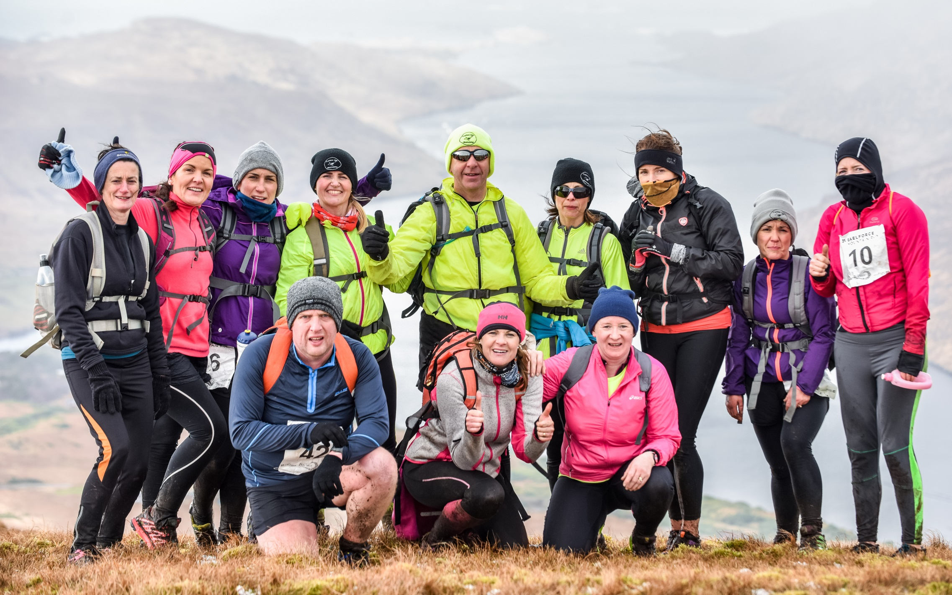
GAELFORCE DUBLIN
OVERVIEW
Wicklow is often seen as the adventure playground of Dublin but Gaelforce would like to contest this and offer Dublin's very own Adventure race. Their proposal is to run an adventure race based in the county of Dublin, ‘Gaelforce Dublin’.
They propose to run a race starting and finishing in Tallaght stadium. This event will offer competitors either a Full distance or Sprint distance adventure race course widening the events appeal to those not only living in and around Dublin but all over Ireland.
The Venue: Tallaght, and Corkagh Park
The areas have many positives:
Urban location which can comfortably accommodate such an event with regards start/finish lines, access, parking etc
The close proximity to rural secondary roads which are necessary for such a race.
A suitable venue for an associated festival.
More information/background available from July’s SPC
Notes:
Leverage the proximity of the outdoors – mountains, rivers and reservoir to the City.
Gael Force looking at East coast (Bray Cliff Run) but we weren’t on radar until approached.
Shows the potential of the County…but also the awareness challenge – confirms our marketing proposals.

Slide 3
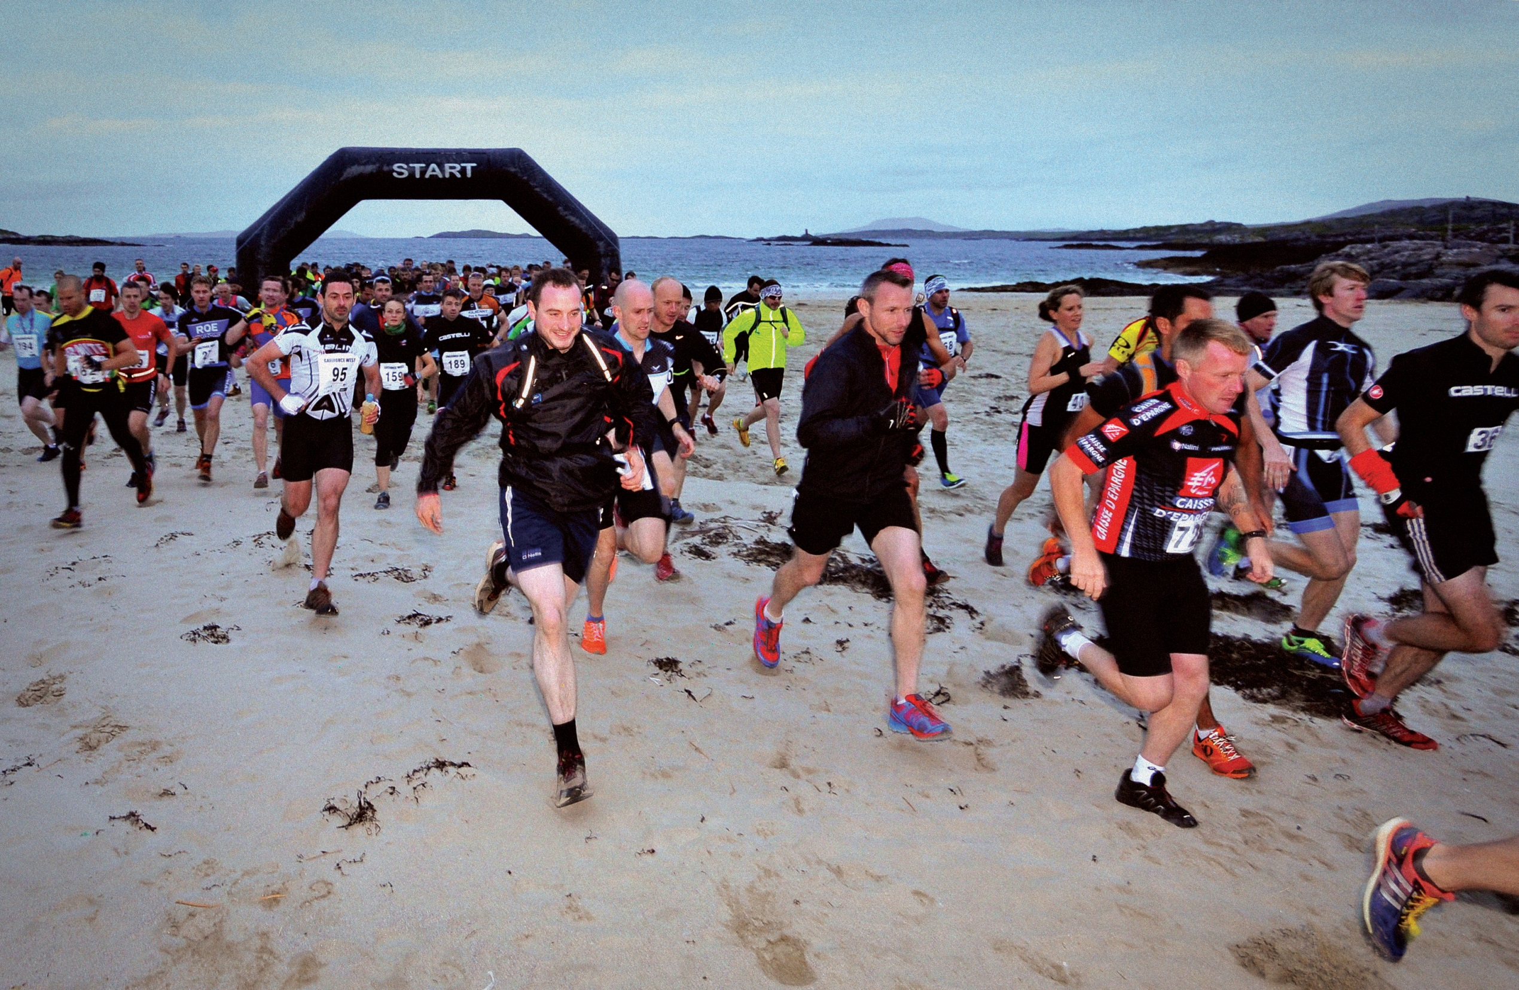
WHAT IS GAELFORCE DUBLIN?
GAELFORCE DUBLIN:
ADVENTURE RACE ACROSS SOUTH DUBLIN COUNTY
Date: 18/02/17
TALLAGHT – KIPPURE – TALLAGHT
Race 1: Full Course
Race 2: Sprint Course
Killary Gaelforce is Ireland's premier adventure event company.
In 2006 they brought the first one day adventure race to Ireland and since over 16,000 people have participated in Gaelforce West.
In 2016 they organised 11 events with over 5,500 competitors.
A proven track record of safe, well organised and excellent events.
Date: 19/02/17
CORKAGH PARK
Race 3: Operation Transformation
Race 4: Youth and Mini Race
Notes:
Who are Gael Force – best in class – in addition to YOY growth, won many tourism awards in terms of responsible tourism etc.
What is it: 2 days – two different types of adventure races.
When is it…18th and 19th Feb – originally following weekend.

Slide 4
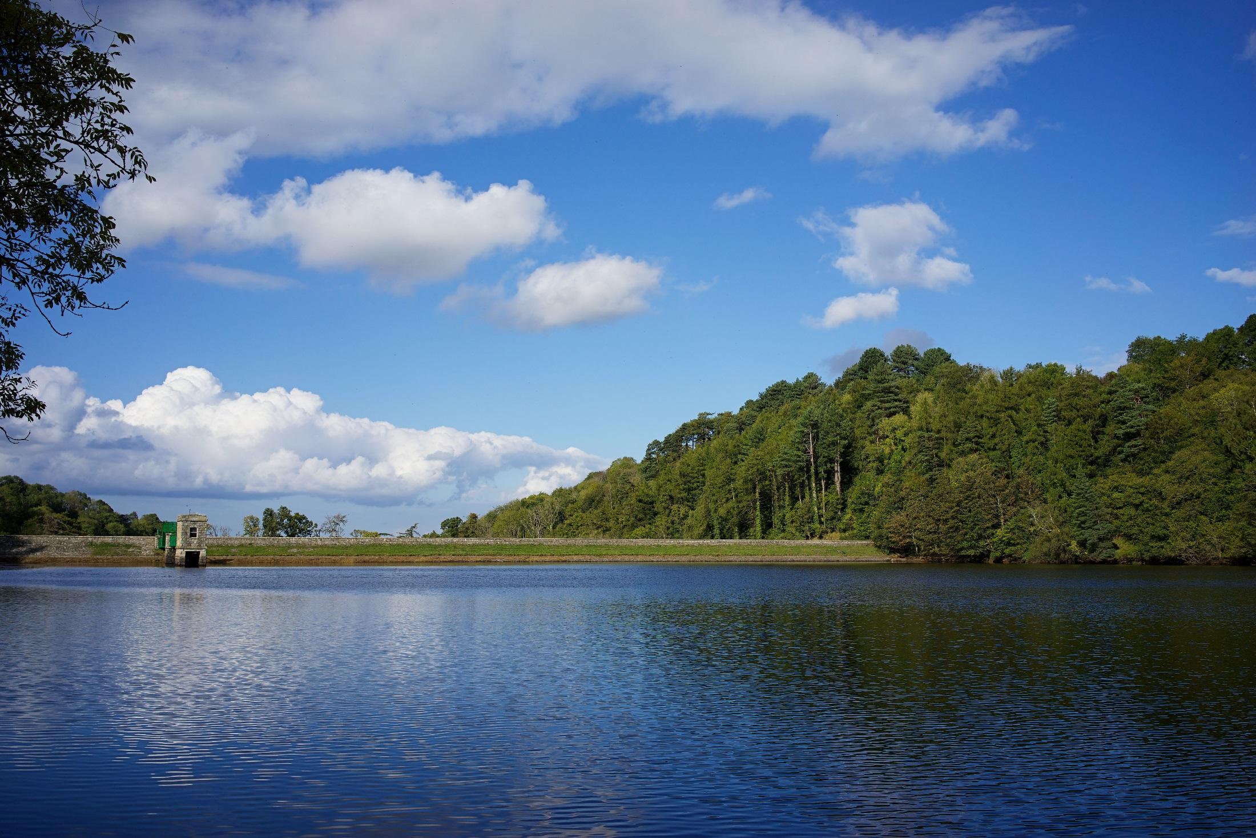
GAELFORCE DUBLIN
Date: 18/02/17 (Saturday)
TALLAGHT – KIPPURE – TALLAGHT
ROUTE:
Cycle: Tallaght Stadium to Bohernabreena Reservoir
Kayak: Bohernabreena Reservoir
Run: Bohernabreena to Kippure and back
Cycle: Bohernabreena to Tallaght Stadium
Distance: 30- 40km approx
Cycling: 15km
Mountain Run: 16km
Kayak: 1km
Date:19/02/17 (Sunday)
CORKAGH PARK
ROUTE:
Youth, family, and mini run, cycle and kayaking throughout Corkagh Park.
Family Festival Feel
Notes:
What it is in more detail:
Sat: Adventure race – cycle – kayak – run – Stadium – Reservoir – Kippure.
Sun: Youth Race in Corkagh, family festival feel
Meeting GF next week to finalise details of route.
Grateful to DCC for access to reservoir.

Slide 5
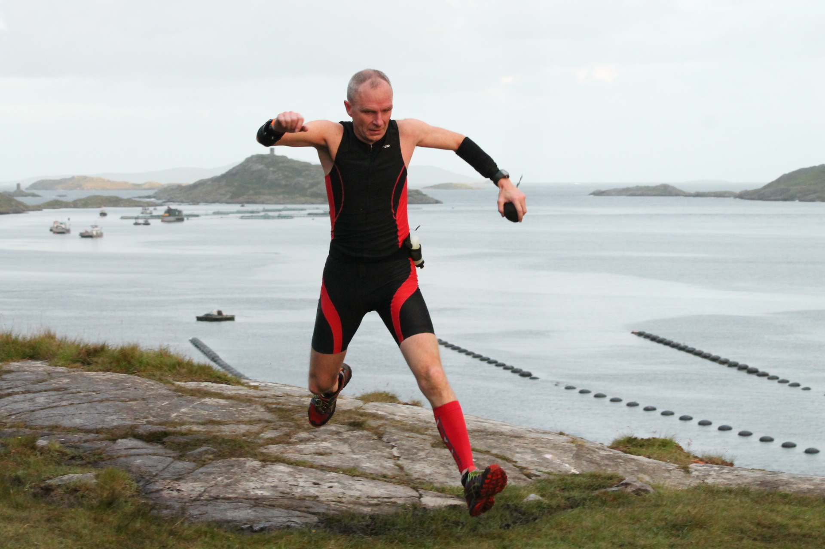
THE KILLARY GAELFORCE COMPETITOR
85% from Ireland, 15% International
Above average education and income levels
Driven, high achieving individuals
Technology savvy
Largest age category between 25 – 45, 83% of competitors
30% female, 70% male
Notes:
Economic opportunity – target markets..

Slide 6
KILLARY GAELFORCE DIGITAL REACH
WEBSITE* www.gaelforceevents.com
Unique users – 107,000 +
Page views – 1,067,700
SOCIAL MEDIA*
Facebook – 18,900+
Twitter – 1,800 +
YouTube
KG Blog – 7,000+ readers in 2016
EDM*
Database of 19,000 +
Weekly newsletter
EVENTS
11 events from March - November
*Data from April 2015 – April 2016
Notes:
A strong brand with a strong following – a great opp for S D County

Slide 7
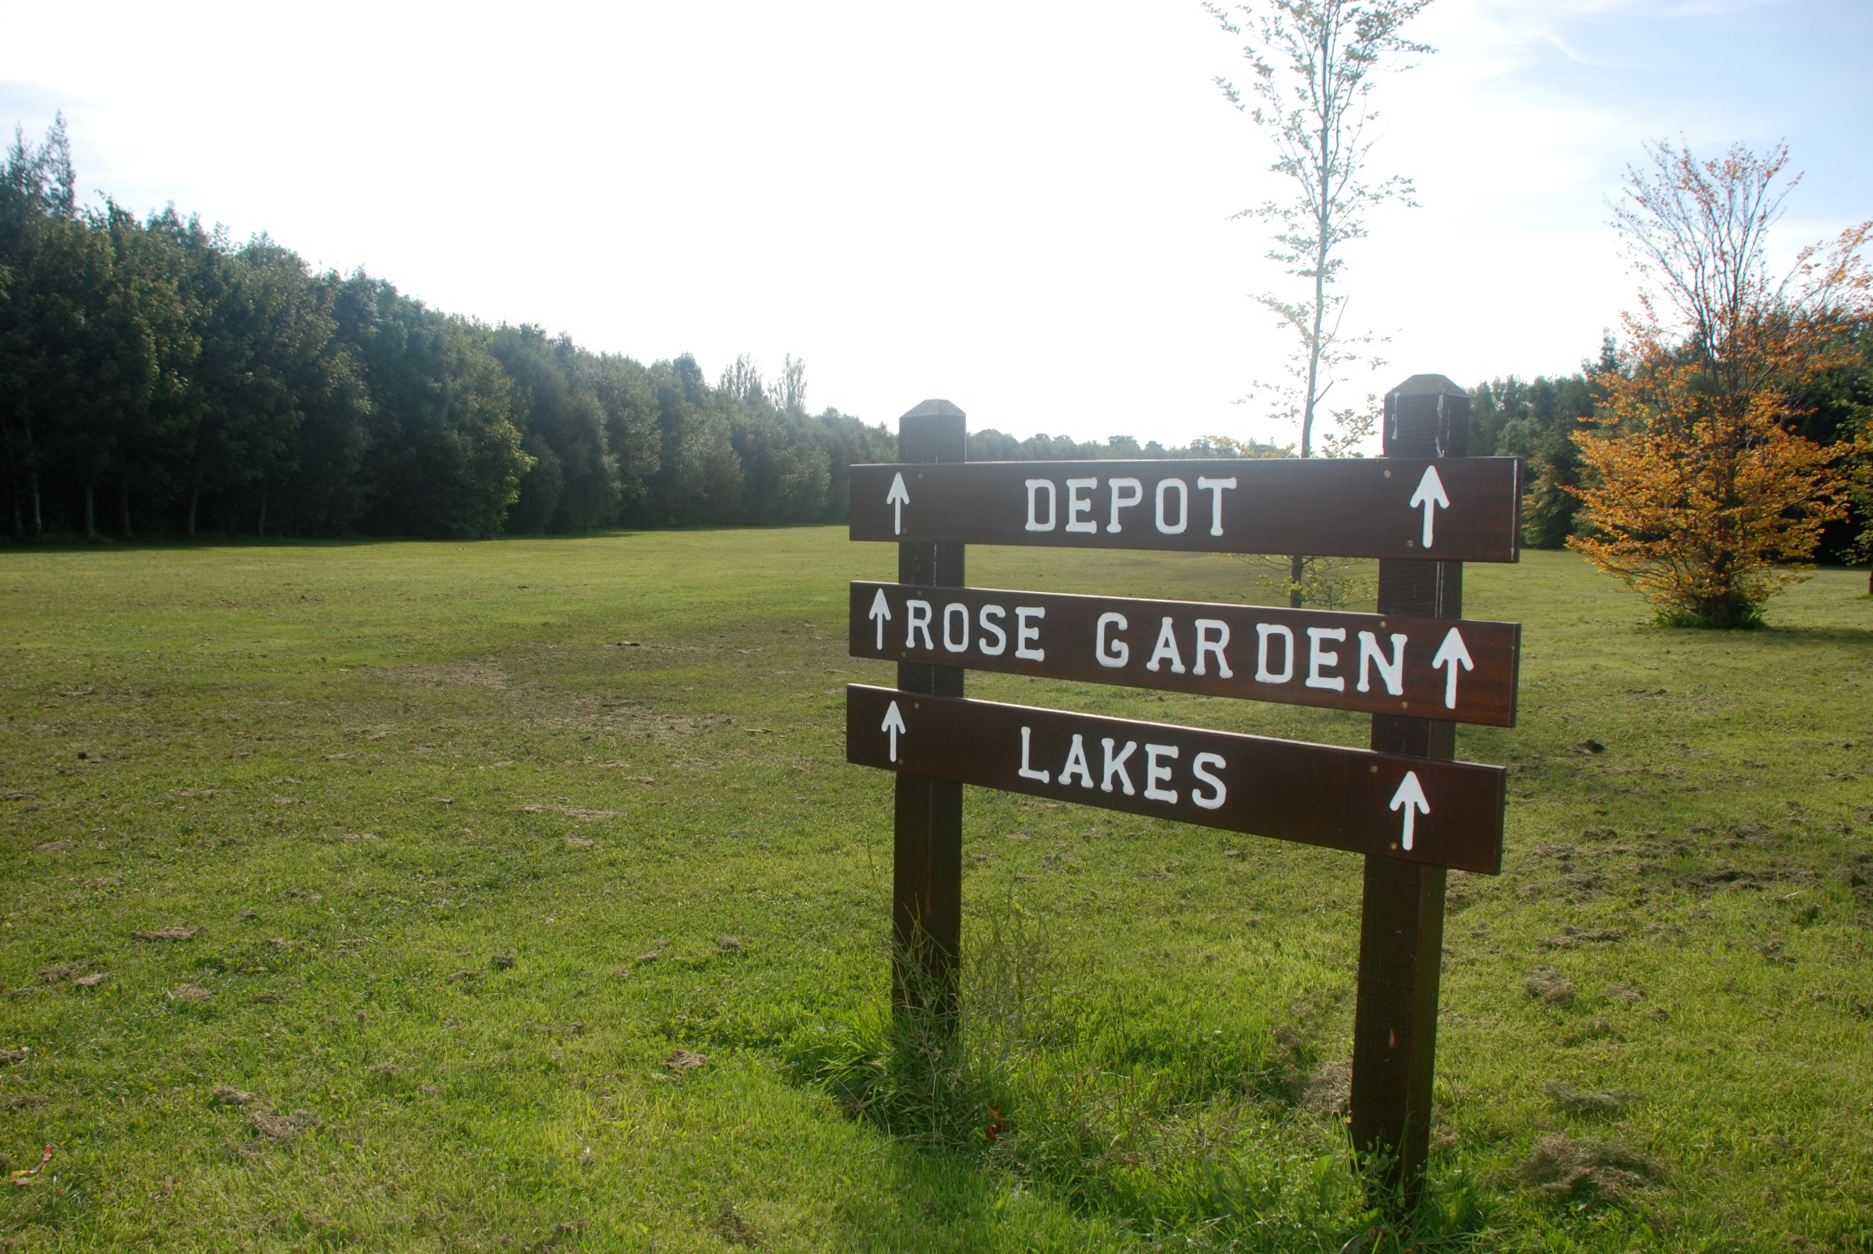
GAELFORCE DUBLIN
ROLES AND RESPONSIBILITIES
SOUTH DUBLIN COUNTY COUNCIL
Funding to agreed limits
Promotion & marketing with partners
Negotiation of routes and venues
Provision of agreed material – barriers etc
SOUTH DUBLIN CHAMBER
Employment of event coordinator
Ancillary Festival interventions
Promotion & marketing with partners Sponsorship via members
GAELFORCE
Organisation and liaison
Safety & Insurance
Promotion and Marketing
FÁILTE IRELAND
Mentoring advice as required
Marketing & promotion supports
Notes:
Roles – SDCC – negotiation of routes ongoing through summer – sale of Kippure lands..
Chamber – organisation with Gael Force, sponsorship – prizes
Gael Force – running.
Failte – marketing – along with all partners.
Utilise the lead in period to promote things to do in the County – Chamber develop packages with industry

