Slide 1
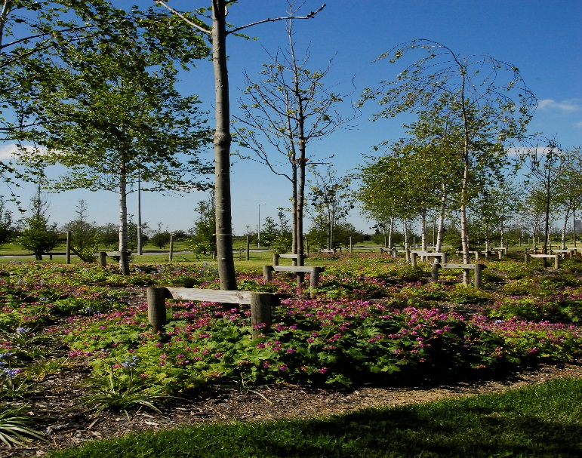
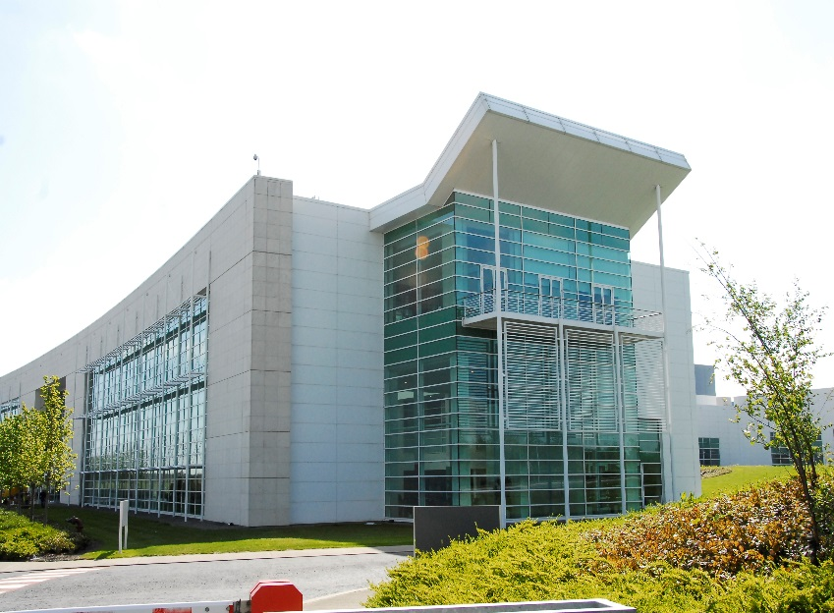
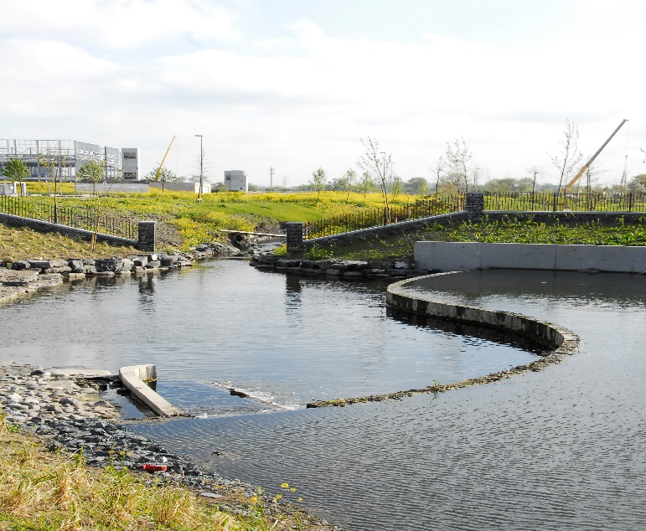
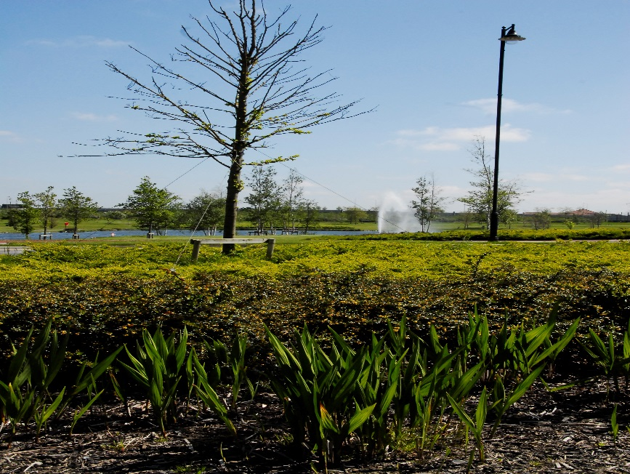
Welcome to Grange Castle
Business Park

Slide 2
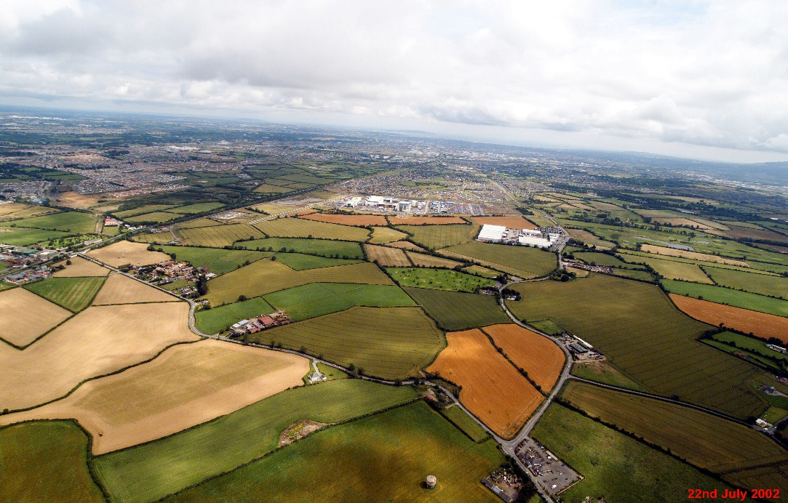
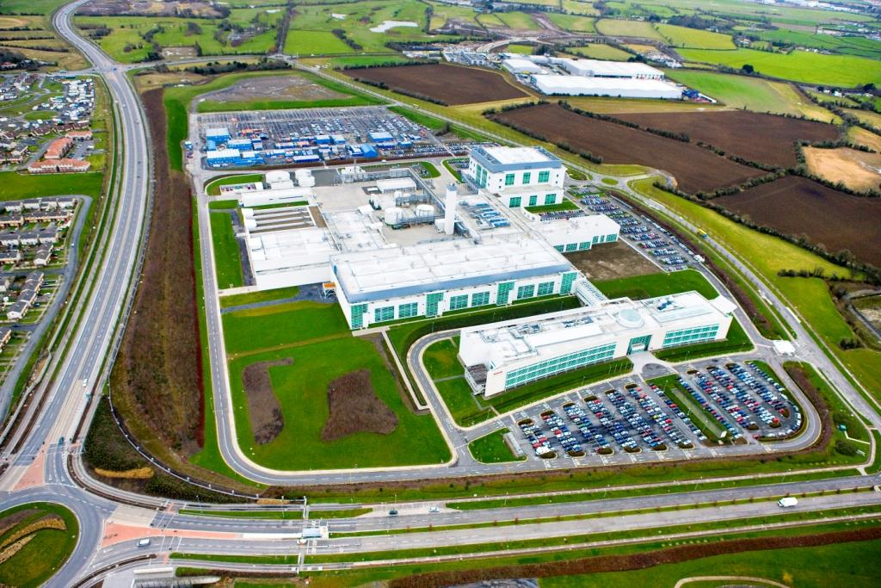
Business Park - History
South Dublin County Council formed 1994
Grange Castle was identified as strategic
business location
Phased Expansion of land-bank: 200 to 475
acres. Now embarking on another phase,
similar in size and nature.
Construction of the park commenced in
2001 and Wyeth ((Pfizer) were the first
tenants.
The Park is managed by Grange Castle
Facilities Mgmt Ltd
Current tenants: Pfizer, Microsoft, Takeda,
Aryzta, Under construction: Microsoft,
Grifols, Google

Slide 3
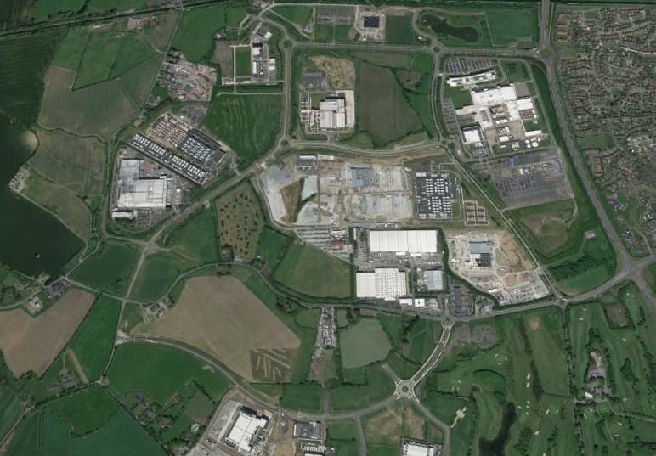

Slide 4
Recent & Current Works
Central carriageway opened Sept 2014, Google access road opened Nov 2015, Interxion access road opened June 2016
Revised marketing plan updated in 2015
Utility enhancement: 110 kV and 220KV infrastructure
Transport: R120 & Nangor road – to be on site end 2016
Continued client interest in Park, Bio-pharma, IT, Manufacturing
Continued maintenance/repair of high quality landscaping, cycle-tracks
Duct Proving and Repairs – Complete – Duct 2 & 6 being leased to Microsoft and Duct 5 in being leased to Interxion
Peamount Wall Boundary (per T&C of Acquisition of lands) – Work in Progress and due for completion by end of September 2016
Grange ‘The Castle’ - Eddie Conroy, County Architect looking at feasibility of preserving the structure to a standard suitable to open access to the periphery of the Castle thus developing a ‘pocket park’. Survey, Ecological and Architectural service have been commissioned.

Slide 5
Recent & Current Works
Grifols: Phase 1 Opened on 24th October 2015.
Microsoft: DUB 6 substantially complete. DSF 70% complete. DUB 07/08 Granted planning approval late 2015. DUB 9, 10, 12 & 13 granted planning approval on 13th June 2016 (SD16A/00/88).
Google Opened June 2016
Interxion facility is 75%+ complete
Pfizer have been granted planning permission for the construction of 5 Storey BioPharma manufacturing facility
Office Brief – To examine the feasibility of developing a strategic site within the park for office purposes - 2No. expressions of interest received.
Eirgrid. S.I. Application granted by ABP 28/06/16 now subject of Judicial Review

Slide 6
Latest News
Pfizer submitted planning application for production expansion – granted 31/08/2016. 35,000m2
Grifols Irl Ltd submitted planning application for production expansion – due 08/09/16. 20,000m2
Interxion – 75% complete on site build.
Interxion Access Road – Clonmel Enterprises have completed works
Microsoft – Planning permission in place up to DUB 13.
Eirgrid – S.I. Application under granted by ABP 28/06/16. Subject of JR by landowner
Capital Programme – Nangor Road / R120: Approved for funding by DTTAS. CPO is approved for R120
Archaeological – GC South: Site Investigations ongoing
Edgeconnex – Planning for datacentre approved 11/08/16

Slide 7
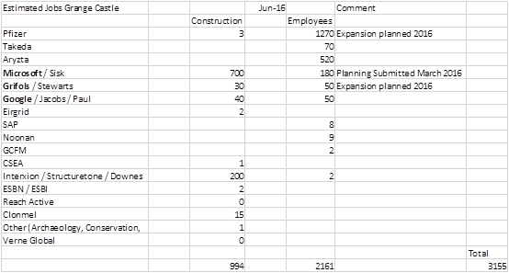
Employment Statistics

Slide 8
Future Strategy Development (Where next?)
Options considered to further develop FDI lands
Profile Park – but potential very limited. Sites small and poorly laid out.
Council owned lands adjacent – limited remaining sites.
Grange Castle West – Clutterland site acquired previously. Development potential. Some lands already zoned
Additional lands acquired 2015 c 450 acres-largely unzoned.

Slide 9
Master Planning
Planning
Roads
Water Services
Surface Water & Flooding
Power
Fibre
Permeability
Public Transport

