Slide 1
Rathcoole Car Parking issue
Context

Slide 2
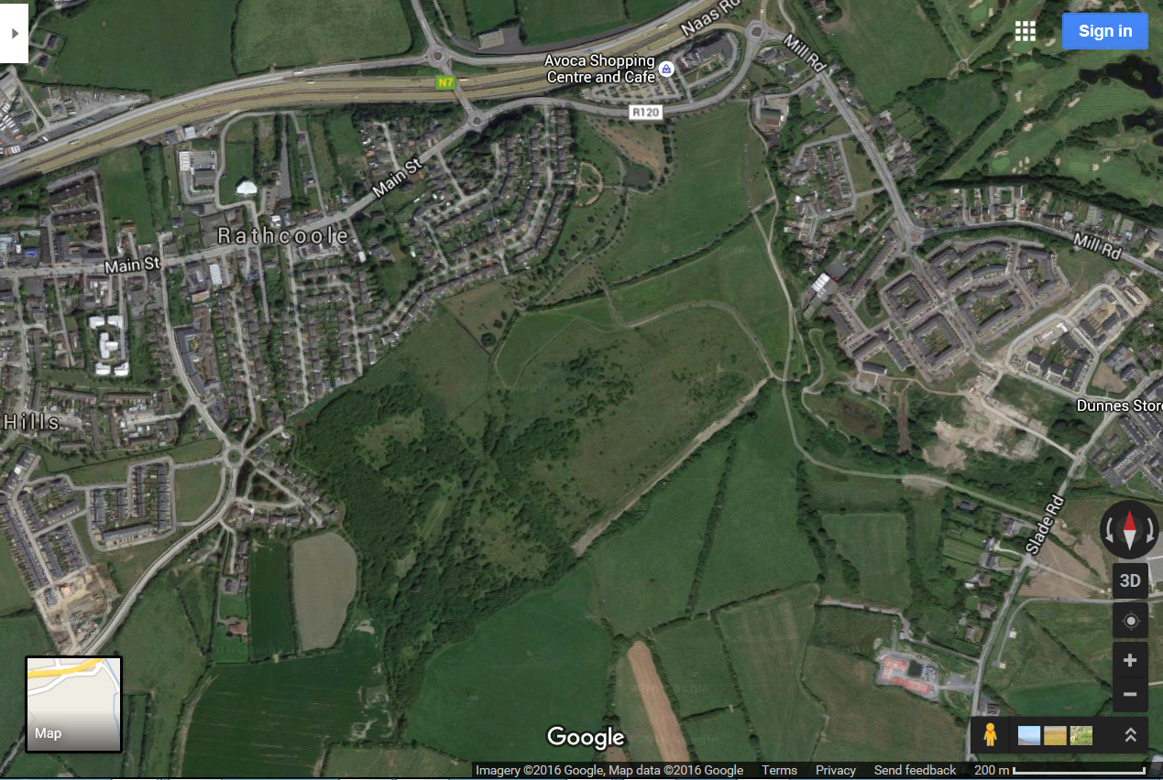
Fitzmaurice Road and Parks Depot options
Beechwood Lawns
Springbank Cottages
Future By Pass Road

