Slide 1
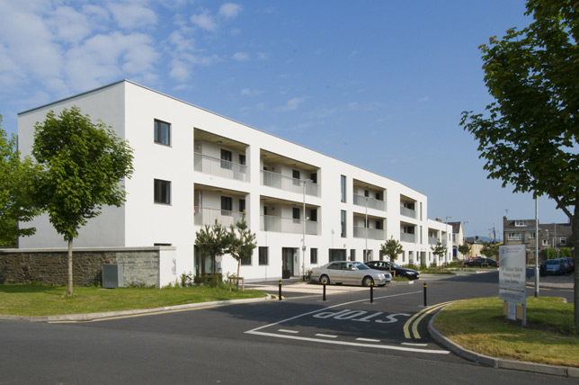
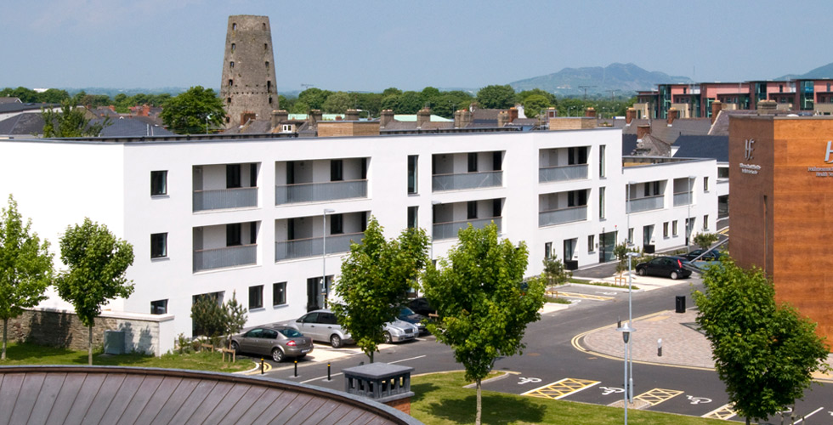
Housing for Older People:
Future Perspectives
Aisling Costello
Age Friendly Ireland

Slide 2
SLIOTAR Project
Looks at national and EU housing and support models for older people and learned what gives good outcomes
To meet the needs, we need to think differently
Locate new developments close (walking distance ) to services and include adaptable design
Integrate technology into developments
Integrate social supports into developments

Slide 3
SLIOTAR - Age Friendly Housing
Housing Design
Key Features
Location
Accessible
Attractive and Desirable
Flexible

Slide 4
Older Peoples Voice
Older people want to stay living in their own home and community
“I want to stay living in my home as long as possible”
“Raheny is my home, whenever I go away, I can’t wait to come back”
But in appropriate accommodation
“The stairs are terrible; physically I find it hard to climb them”
“I’m on my own, what happens if I have a bad fall!”
And to feel Safe
“Even when I am on my own, I lock myself in and make sure all the doors and windows are closed”
There isn’t a week that goes by where I don’t hear “ about a break in”

Slide 5
Introduction
Literature Review: National and Local Policy
National Positive Ageing Strategy
Social Housing Strategy 2020
Housing Policy Statement 2011
County Development plans & Area Development plans
Results under 4 Areas
Physical Considerations
Technological Considerations
Social Considerations
Cost Considerations
Change the way we think about housing for older people.
Building homes not houses.

Slide 6
Project Research – Case Studies
GNH Complex, Dundalk
Cúltaca, Dundalk
McAuley Place, Naas, Kildare
Local Area Coordination (LAC), Thurrock, Essex, UK
SOPHITAL®, Bamberg, Germany.

Slide 7
Housing Model
GNH Facts
B
“Develop an approach that provides support and care in the home or community as opposed in an institutional care setting”.
Physical Planning & Design
Social Interventions
Technological Interventions
Person Centred
Meet Changing Need
Older Person

Slide 8
GNH (Great Northern Haven) – Context
16 Apartments
Located 1km from Dundalk town centre.
Technology < 2000 sensors.
Social Interventions – Cúltaca.
15 Residents moved in 2010, 10 from Housing List, 5 from HSE care

Slide 9
Physical Interventions – key facts
GNH / McAuley Place
Located in town centre.
Developed on a brownfield site.
Services within walking distance.
Designed to be adaptable to be lifetime home./ Not adaptable, reused a historic building
Energy efficient / Part M
16 / 53 apartments with common /community facilities
Allocation Policy/ Waiting list for apartment
Social Supports: Cultaca/ HSE – Support for residents.

Slide 10
Physical Interventions - Recommendations
Demographic analysis – predict likely demand.
Location –within walking distance (300-500m) of services.
Retail Planning Guidelines (2012) – Hierarchy Approach
Placemaking – ‘attractive’ environment to live in.
Re-use of brownfield land.
Designing to allow adaptation to meet the changing needs.
Centre for Excellence in Universal Design’s (CEUD).
Adapting allocation policy to include those at risk of entry to full time care.

Slide 11
Technological Interventions Key Facts
GNH
Technology integrated into design.
PIR (passive infra-red) motion sensors
Contact sensors on doors and windows.
Sensors on light-switches.
Electricity sensors.
Track Feedback to iPad.
Wellbeing
weather
sleep
movement
security
Emergency Call System.
Home automation - adaptability
SOPHITAL®
Wireless technology.
Can be fitted anywhere in the home.
Flexibility – products can be use anywhere in the community.
Range of technology features
Safety and security
Health monitoring
Comfort
Emergency support system

Slide 12
Technological Interventions - Recommendations
Provide broadband in older person accommodation
Minimum technologies that would support older people;
Safety & Security
Emergency Call System, heat and flood sensors
Door & Window contact sensors, linked to alarm
Hob/Stove connection, All Off switch
Video intercom.
Health Monitoring
Weight and Blood Sugar and Pressure Monitoring.
Fall and wander monitors
Comfort
Adjustable heat control, remote using smart controllers
Energy usage monitoring.
Door or window actuators.

Slide 13
Technological Interventions
Main Learnings from GNH and SOPHITAL®
Technology is welcomed by older people
where it improves safety and security
monitors health and saves journeys.
communication technology supports social connectedness
Training on the use of technology helps adoption
Technology can
encourage longevity of tenancies.
be tailored to meet the needs of the resident.
be used to retrofit existing homes

Slide 14
Social Interventions
GNH – Cúltaca & Local Area Coordination (LAC)
Working one to one with the person– develop personal plan.
Developed an ‘expertise’ in supporting older people.
Address service fragmentation and poor coordination.
Outcomes
Improved health and wellbeing and independence
Reduce demand on acute services.
Empower older people to make their own decisions.
Constantly developing supportive networks – Netwell Memory Café.

Slide 15
Social Interventions - Recommendations
Housing providers should partner with local support services prior to developing housing for older people.
Develop further initiatives (similar to Cúltaca or LAC) which aim to strengthen community capacity and social networks.
Person-centred approach,
Develop 1:1 relationship
Assist in signposting to available services and addressing gaps in service provision and
Supporting communication between service providers.

Slide 16
Cost Effectiveness
Average cost associated with keeping one Resident in an Apartment in GNH
Charges | Cost (per week)
Average Rent* | €30
Service Charge* | €12
Average Electricity Bill* | €3.75
Average Heating Bill* | €7
Average Food Bill (@ 31.7% of Income - €230.30)** | €73
Average Local Authority Cost (Differential Rent) ^ | €4.90
Total (No Care Package) | €130.65 [A]
Care Package (@ 3 hours x €21.90 p/hr***) ^^ | €65.7 [B]
Total [A+B] | €196.35
Care Package (@ 15 hours x €21.90 p/hr***) ^^ | €328.5 [C]
Total [A+C] | €459.15
Sources
*Figures provided by Clúid Housing Association
** Bantry White, et al. (2011)
^ Cost covered by the Local Authority
*** www.careforme. ie/Rates/
^^ Cost covered by the HSE
**** www.hse.ie/eng/ services/list/4/olderpeople/nhss/costs
Costs of Nursing Home Care - Average across all regions****
Public (March 2011) | Private/Voluntary (January 2015)
€1,245 p/w | €898 p/w
Average in Co. Louth****
€1,272 p/w | €910 p/w

Slide 17
Cost Effectiveness - Recommendations
Further comparative research on operational costs.
This would inform the development of a model of shared costs from an operational perspective.
New capital costs funding model.
This would inform the development of a model of shared costs from an capital housing and health perspective.

Slide 18
Overall Conclusion
To meet the needs, we need to think differently
Locate new developments close (walking distance ) to services and include adaptable design
Integrate technology into developments, enhancing safety and security, health monitoring, comfort and social connectedness
Integrate social supports into developments;
access to information, find non health service based solutions and reduce demand
‘Whilst the design of accommodation can be beneficial, the accompanying care and support packages are crucial to supporting quality of life. It seems they work synergistically’ (Social Research Centre, 2010).
Notes:
Its for people who are aging now.
35% of those in LTC are low to medium dependency.

Slide 19
What’s next?
This model of housing can;
Support older people to stay living at home for longer.
Provide housing that will cater for future demographic changes.
Ask today: consider
Assessment of need at local level
Reduced parking and green areas facilitate Brownfield sites
Development contribution – won’t affect AHB’s
Procurement – Inclusion of Accessibility (Monaghan)
Minimum Design Standards – CEUD May 15

