Slide 1
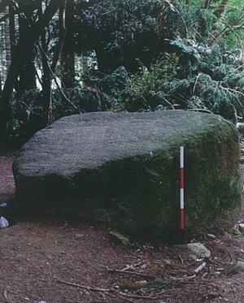
County Council meeting – 14TH March 2016.
Dublin Mountains flagship project.

Slide 2
DRAMATIC VIEWS…………………

Slide 3
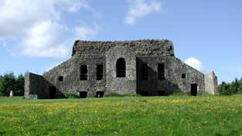
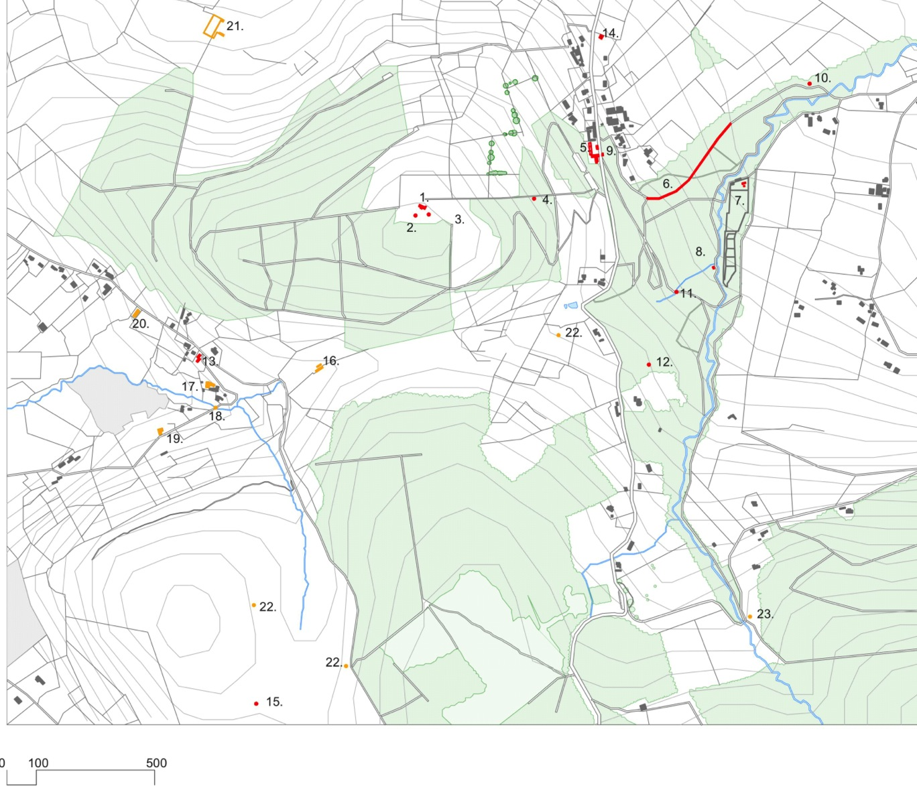
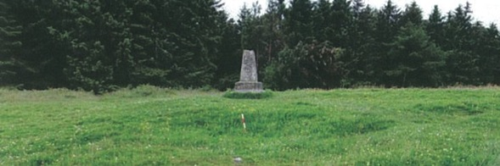
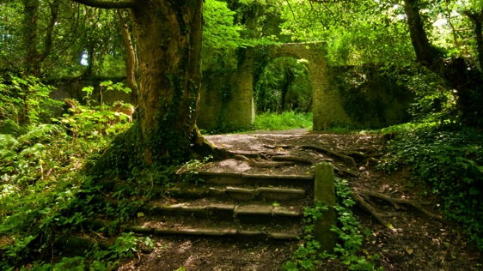
HISTORY/ARCHEOLOGY

Slide 4
The Project : Tourism Strategy 2015
- Dublin Mountains – a valuable resource
- Positions the outdoors as a visitor experience
- Flagship project – an attraction destination
Feasibility Study & Masterplan
- Architect led team – PKA, Paul Keogh Architects
- Multi-disciplinary team
- “Wow” factor – “Must See” destination attraction
Where? Feasibility / Constraints
- To be within SDCC / Coillte lands
- To connect with existing routes and trails
- On site cultural / natural heritage

Slide 5
SELECTION MATRIX – SIX SITES EXAMINED.
Site Options
- Cruagh
- Featherbed
- Hellfire
- Masseys Estate
- Stewards House
- Hellfire and Masseys Estate Combined

Slide 6
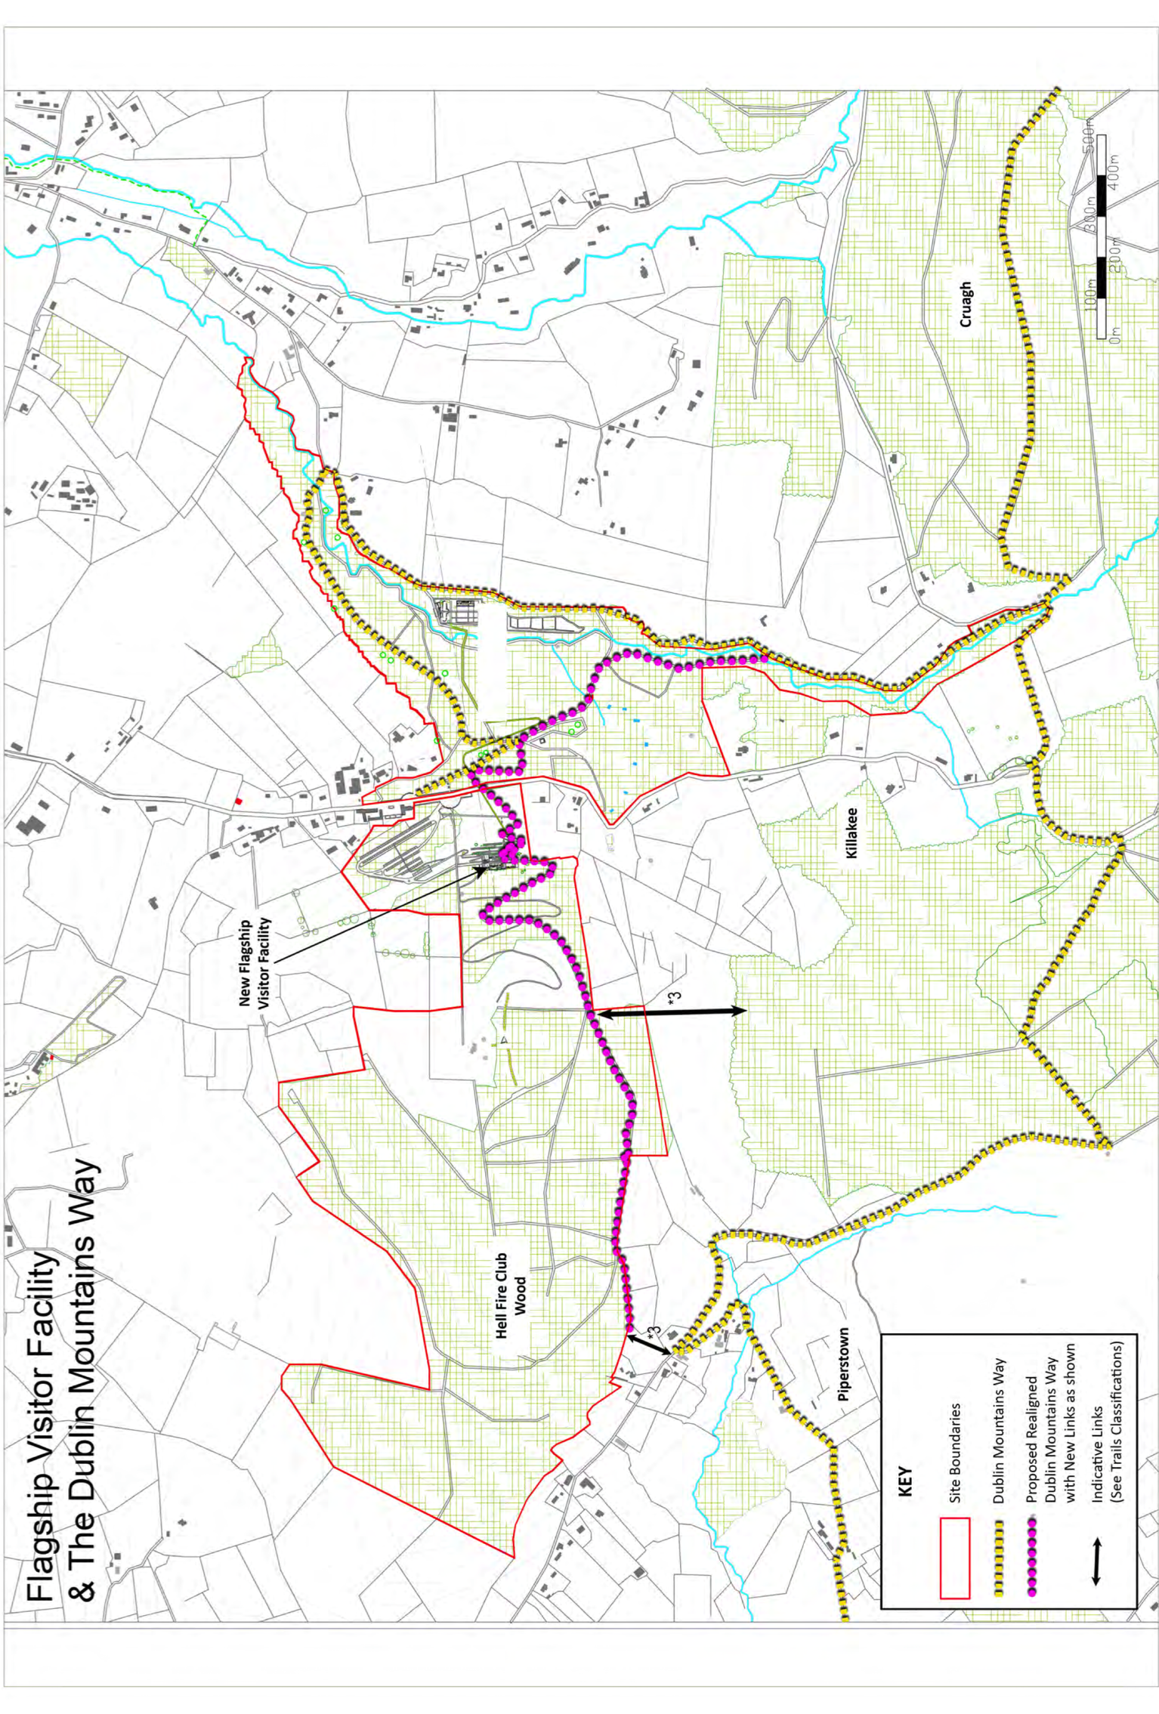
Preferred option :
Hellfire and Masseys Estate Combined
“DRAFT Masterplan consolidates and defines the visitors’ potential appreciation of a unique place and experience in the Dublin Mountains.”

Slide 7
DRAFT MASTER PLAN…

Slide 8
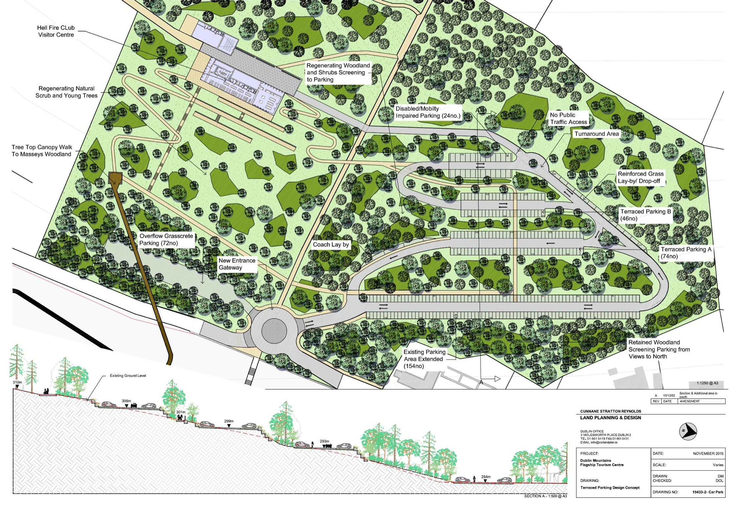
SITE LAYOUT

Slide 9
PROPOSED FLAGSHIP BUILDING (PLAN)

Slide 10
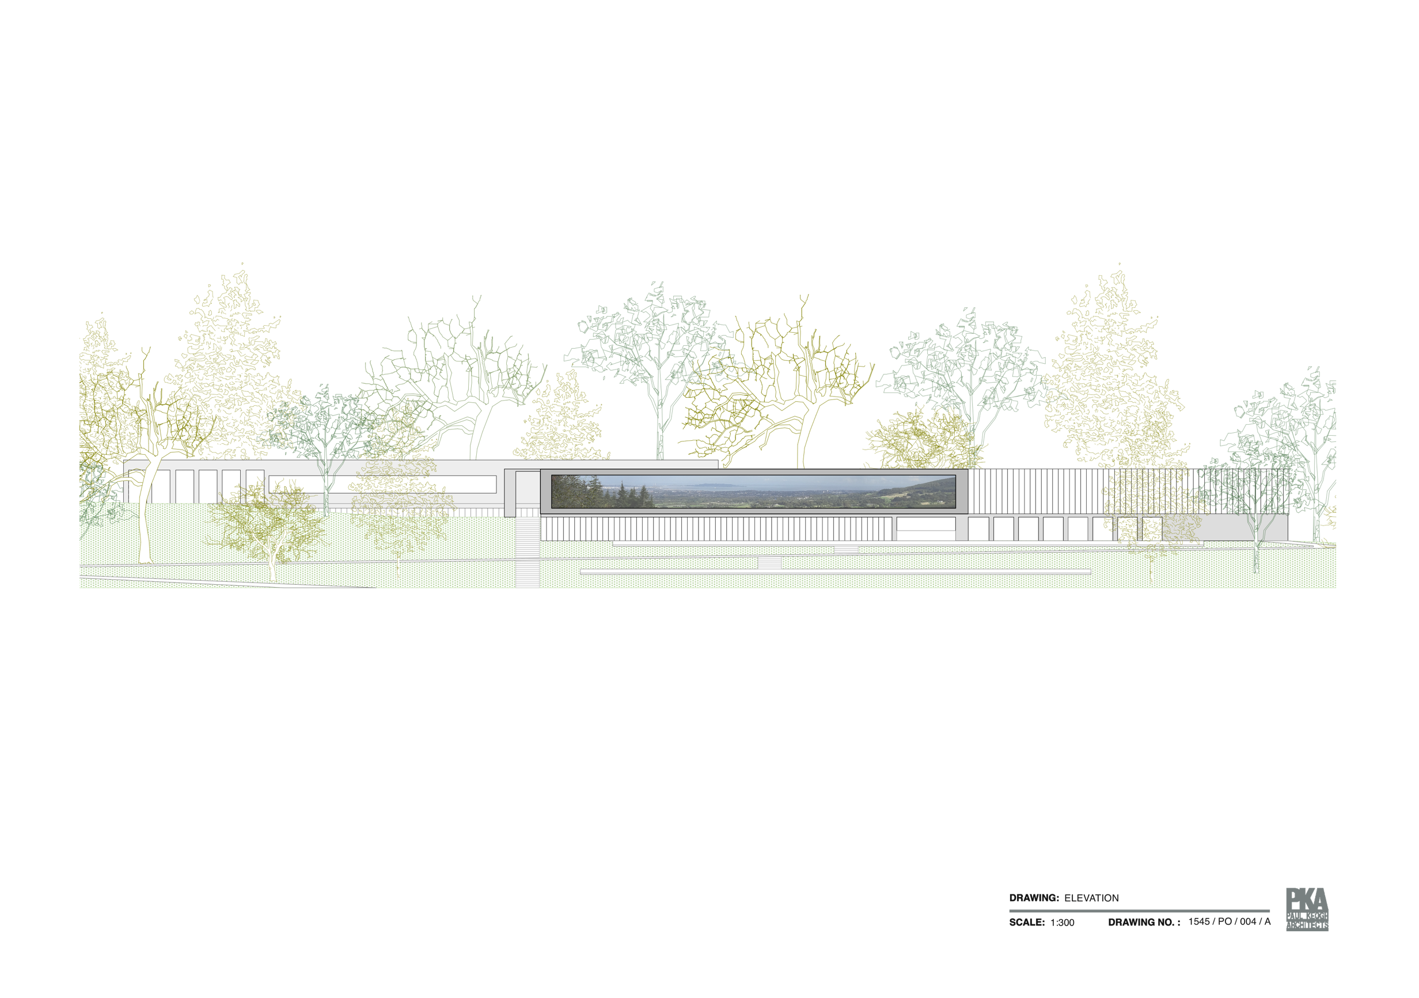
PROPOSED FLAGSHIP BUILDING (ELEVATION)

Slide 11
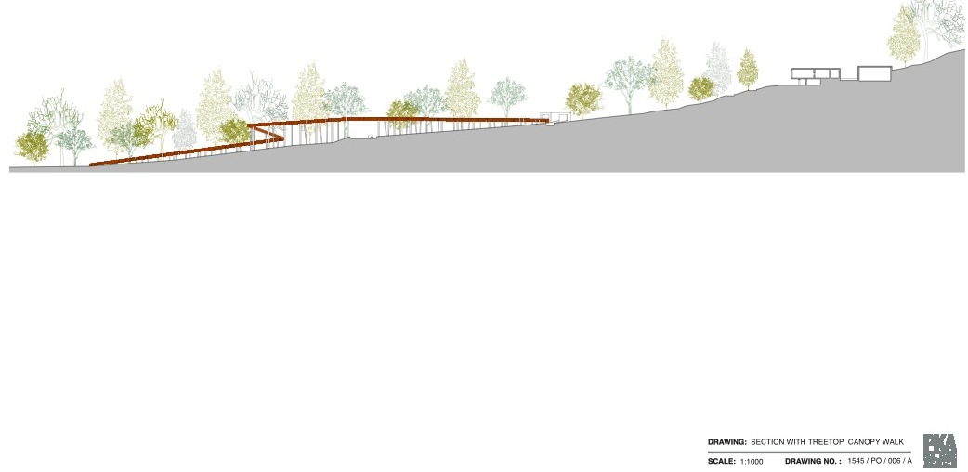
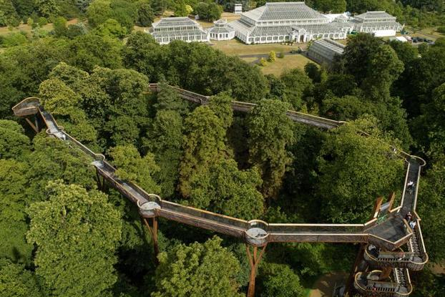
…THE TREE TOP WALK –link between Hellfire & Masseys…
Kew Gardens – Surrey, (UK)

Slide 12
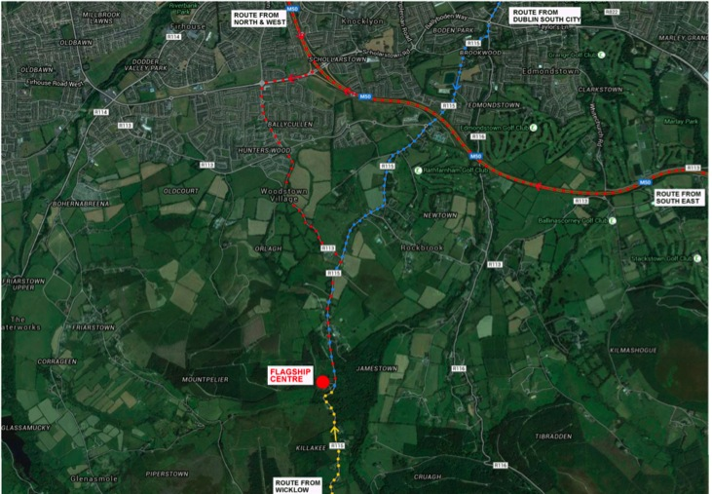
TRANSPORT – MANAGING VISITOR NUMBERS
1. Public Transport
Public Transport will be promoted as the primary means of access. For this a short 2.5 km long shuttle bus service is proposed to connect with the existing high frequency Dublin Bus Route No.15 at Woodstown Village / Stocking Avenue, from the Stocking Lane Coach/Car Park. Other services such as an increased frequency to Rockbrook, and a dedicated tourist bus from Dublin Castle should be considered.
2. Car
The masterplan proposes an extension of the existing car park at the Montpellier Hill Site to hold a capacity of 300 cars, 24 of which are disabled spaces. Pedestrian routes from the car park to the centre and to the tree canopy footbridge provides safe access to the sites.
3. Coach
Provision is made in the car park for coach drop off, and the masterplan proposes the consideration of a coach park at Stocking Lane with a shuttle service.

Slide 13
VISITOR PROJECTIONS-review by Jim Power economics
 | Year 1 | Year 2 | Year 3 | Year 4 | Year 5
Estimated Visitor Numbers | 100,000 | 150,000 | 200,000 | 250,000 | 300,000
Gross Wages (€) | 605,340 | 768,210 | 993,313 | 984,675 | 984,675
(PAYE/PRSI/USC/Employer’s PRSI) (€) | 242,136 | 307,284 | 397,325 | 393,870 | 393,870
Net Wage (€) | 363,204 | 460,926 | 595,988 | 590,805 | 590,805
Multiplier Effect (€) | 544,806 | 691,389 | 893,982 | 886,207 | 886,207
“The proposed flagship development in the Dublin Mountains should be viewed in the context of three separate tourism objectives. There is the national tourism perspective as outlined by Failte Ireland and the Department of Transport, Tourism & Sport; there is the strategy of ‘The Grow Dublin Tourism Alliance’ which focuses on Dublin tourism; and there is the local tourism objective as outlined in the tourism strategy of South Dublin County Council…..
…The proposed flagship tourism attraction in the Dublin Mountains has the potential to become an integral part of the overall Dublin tourism portfolio and make a significant economic and financial contribution to tourism in Dublin and at a national level.”

Slide 14
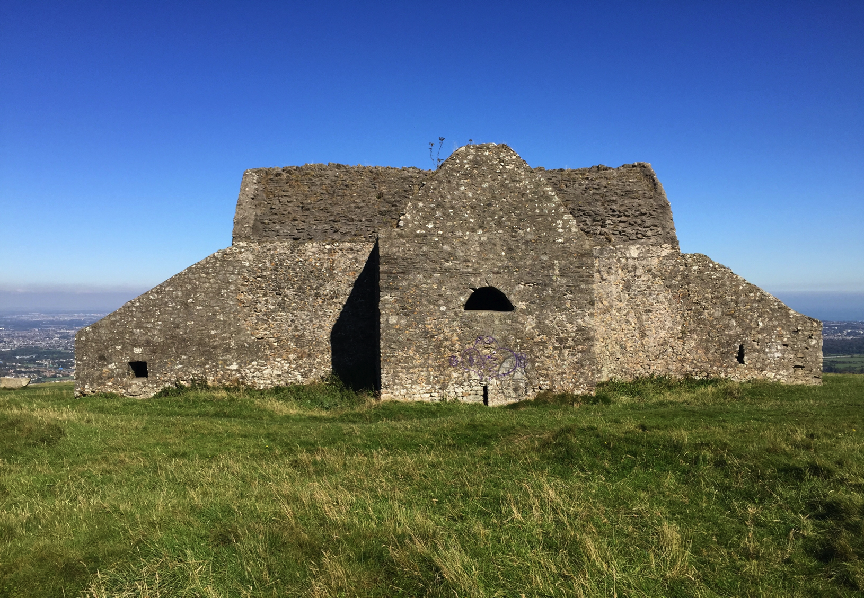
ESTIMATED COSTS
Costs estimated by the Consultants have been tested by an independent Quantity Surveyor and in-house.
Including VAT and fees total costs are estimated at up to 19 Million Euro depending on final design.

Slide 15
NEXT STEPS
MOU WITH COILLTE.
PLANNING PROCESS (EIS –AN BORD PLEANALA.)
IDENTIFY FUNDING. (Subject to Planning)

