Slide 1
South Dublin County Council
Significant Water Management Issues - Public Consultation Document
Consultation
Open 17 June 2015
Closed 18 December 2015
Presentation to November 2015 Environment, Public Realm and Climate Change SPC Meeting

Slide 2
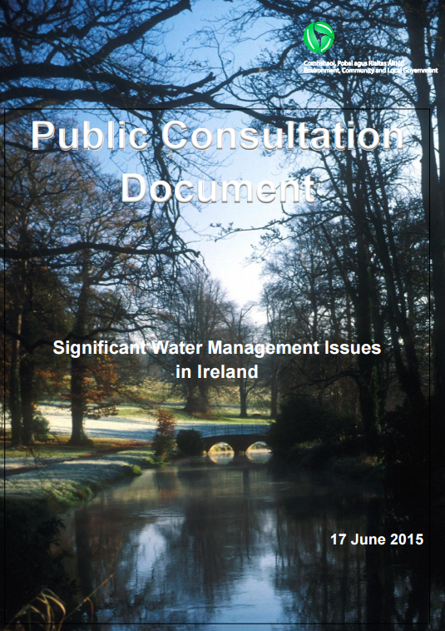

Slide 3
Terms
Cycle 1 = 2009 to 2015 (6 years)
Cycle 2 = 2016 to 2021 (6 years)
RBD: River Basin District

Slide 4
Consultation document layout
Part 1: Introduction
Part 2: Current condition of our waters
Part 3: Pressures on our water environment
Part 4: River basin management planning and the challenges ahead; and
Part 5: The environmental issues to be addressed.
http://www.environ.ie/en/Publications/Environment/Water/FileDownLoad,38703,en.pdf

Slide 5
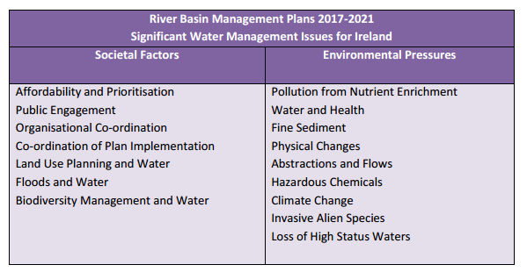
Part 1: Introduction
The main issues discussed in the document are

Slide 6
New National and International River Basin Districts

Slide 7
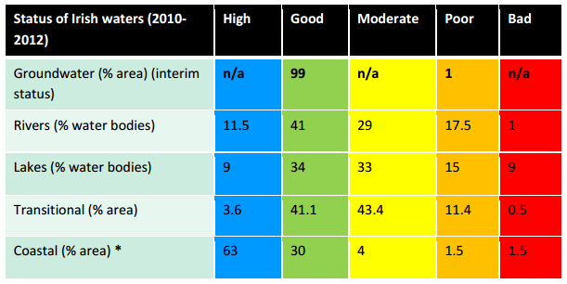
Part 2: Current Condition of Our Waters
The water status assessment for 2010-2012 shows that 47% of rivers, 57% of lakes, 55% of estuaries and 7% of coastal waters (by area) were impacted (Figure 45 ). Only 1% of groundwater bodies are at poor chemical status.

Slide 8
Part 3: Pressures on Our Water Environment
Urban Wastewater Discharges
Agriculture
Forestry
Homes and Gardens
Industrial Discharges
Activities spreading alien invasive species

Slide 9
Part 4: River Basin Management Planning and the Challenges Ahead (societal factors)
Issues are:
Affordability and Prioritisation
Public Engagement
Organisational Co-ordination
Co-ordination of Plan Implementation
Land-use Planning and Water
Floods and Water
Biodiversity Management and Water

Slide 10
Part 5: The Environmental Issues to be Addressed (Environmental Pressures)
Pollution of waters caused by nutrient enrichment
Water and Health
Fine Sediment
Physical Changes
Abstractions and Flows
Hazardous Chemicals
Climate Change
Invasive Alien species
Loss of High status Waters

Slide 11
To summarise
The Minister wants people to have your say. People are therefore invited to consider the following:
Do people agree that the issues facing Ireland’s waters are correctly set out in this document?
Are people aware of other issues that should be highlighted?
What do people think are the most important issues to be addressed between now and 2021?
How do people think the challenges identified should be tackled and what would people do first?
On each issue the Minister is looking for people’s feedback as to what government should do and how everyone can work together to achieve healthy, resilient, productive and valued water resources that support vibrant communities.

Slide 12
What happens next?
Work on the preparation of river basin management plans is currently underway by the relevant authorities. Submissions received in response to this consultation will be taken into account in the preparation of these plans.
In addition:
• Draft river basin management plans will be published towards the end of 2016, and people will have a further opportunity to input and comment on these.
• After further consultation and consideration of all submissions received, final river basin management plans will be adopted by the Minister and published in 2017; those plans will run to 2021.

Slide 13
How to submit your views
Emailing to waterq@environ.ie ; or
2. Sending a hard copy written response to the DECLG “WFD SWMI consultation, Water Quality Section, Department of the Environment, Community and Local Government, Newtown Road, Wexford”
The final date for responses in respect of this consultation phase is 18 December 2015.
End.

