Slide 1
South Dublin County
Elaine Leech: South Dublin County 2016 Co-ordinator

Slide 2
Overview
Ireland 2016 - a National initiative to develop, coordinate and deliver a programme for the 2016 centenary year with local, national, and international events, based on five intersecting themes, drawing inspiration from the ideals of 1916, the Proclamation, and the events of that time- Remembering, Reconciling, Presenting, Imagining and Celebrating

Slide 3
7 Programme Strands
State Ceremonial
Historical Reflection
An Teanga Beo
Youth and Imagination
Cultural Expression
Community Partition
Global and Diaspora

Slide 4
South Dublin County Centenary Programme

Slide 5
Events/Initiatives in South Dublin County

Slide 6
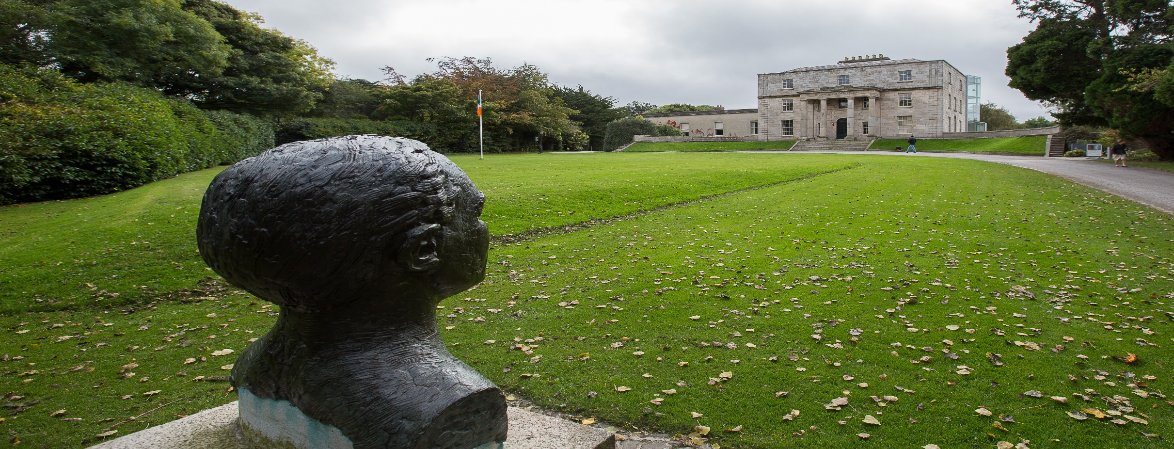
Searmanas Stáit State Ceremonial
An Official visit will take place to Pearse Museum, St. Enda’s Park, to commemorate Pádraig Pearse, the educationalist and literary Figure

Slide 7
Machnamh ar an Stair Historical Reflection
South Dublin and 1916 Rising Exhibition- Physical and Digital
1916 in Rising in Oral History
Development of a County Rebellion Trail
Women of the 1916 Rising
Series of Lectures on the lives of the 1916 Leaders
Dublin Fire Brigade and the 1916 Rising
Paths to Freedom- Many Shades of Green Conference

Slide 8
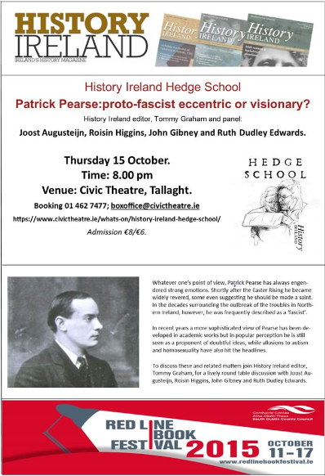
Machnamh ar an Stair Historical Reflection

Slide 9
An Teanga Bheo The Living Language
Seachtain na Gaeilge Átha Cliath Theas – 1st -17th March 2016
Mayor’s Initiative- Bilingual Poetry Competition for Primary Schools
Bilingual Screening of the Birth of a Nation
Féile na Bealtaine
Launch a new Irish Language App

Slide 10
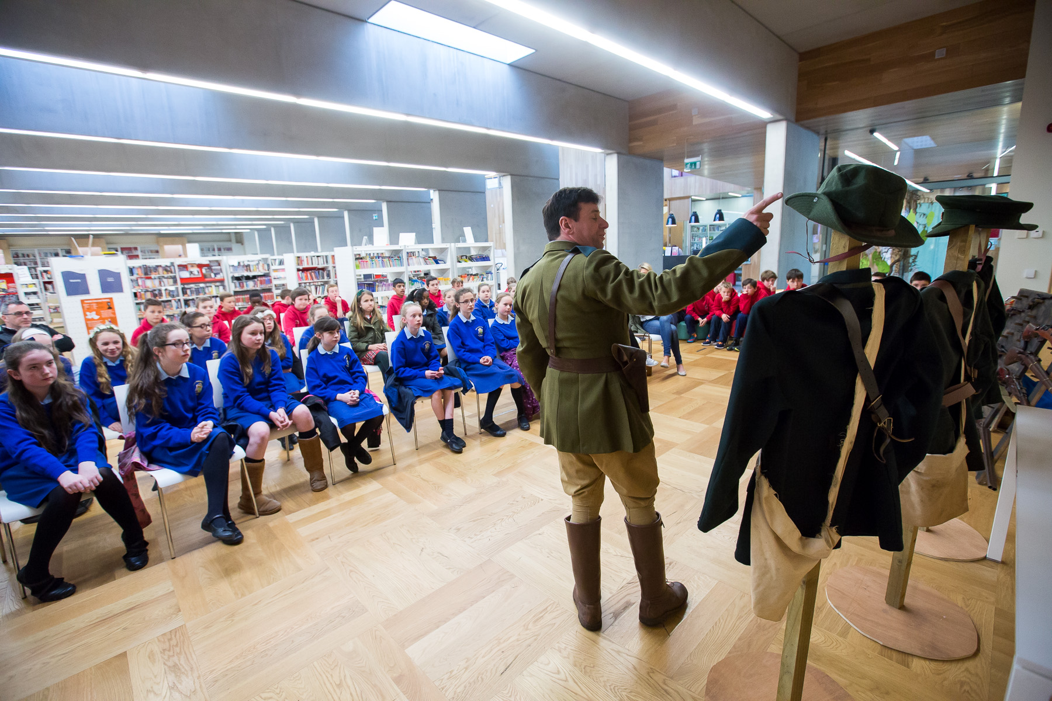
An Óige agus an tSamhlaíocht Youth and Imagination
Proclamation for a New Generation and Time Capsule for 2116

Slide 11
An Óige agus an tSamhlaíocht Youth and Imagination
National Flag Initiative
Proclamation for a new generation
Riots, Rifles and Rebels
Experience life in 1916 workshops for primary students
Schools Postcard Competition
2116- Time Capsule – Comhairle na nÓG

Slide 12
Rannpháirtíocht Phobail Community Participation

Slide 13
Rannpháirtíocht Phobail Community Participation
Consultation Meetings/Workshops:
Comhaire na Nóg
South Dublin Disability Consultative Forum
South Dublin Older Person Ambassadors
Bealtaine Festival
Ballyroan Library
Tallaght Stadium
Lucan Library

Slide 14
Rannpháirtíocht Phobail Community Participation
Commemorations Fund- 45 applications
Rathfarnham/Templeogue/Terenure ACM- 5 applications
Tallaght/Saggart- 13 applications
Lucan/Palmerstown- 11 applications
Clondalkin/Newcastle/Rathcoole – 14
2 outside SDCC’s administrative area

Slide 15
Éireannaigh ar fud an domhain agus an Diaspóra Global and Diaspora
Ireland 2016 provides and opportunity to celebrate Ireland’s strong links with its Diaspora and with out international friends and partners. We want to ensure global participation in the commemorations and promote the best of Irish arts and culture worldwide
The Rising will have particular resonance in the U.S. Five of the Seven signatories to the Proclamation spent periods of time in the U.S. that influenced their thinking and actions.

Slide 16
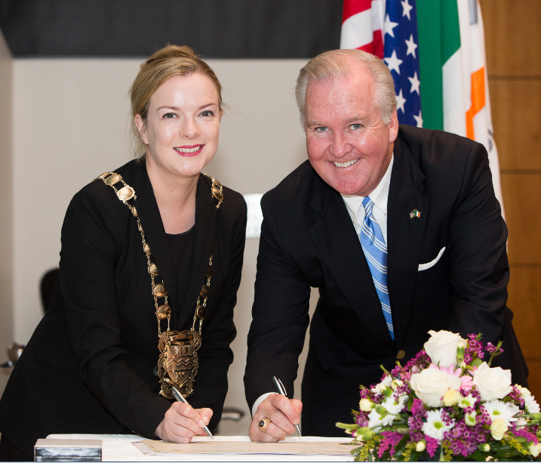
Global and Diaspora
U.S is the only foreign country specifically mentioned in the proclamation, it has the greatest concentration of our Diaspora and contemporary ties are of extraordinary depth and breath.

Slide 17
Léiriú Cultúrtha Cultural Expression
Women of the Easter Rising Portrait Exhibition – Ballyroan Library
The Count, the Countess and Tommy- Civic Theatre
Futures and Past- Rua Red

Slide 18
Léiriú Cultúrtha Cultural Expression
Legacy Project- Development of a Civic Plaza on Grange Road Rathfarnham

Slide 19
Go raibh maith agat
Thank you

