Slide 1
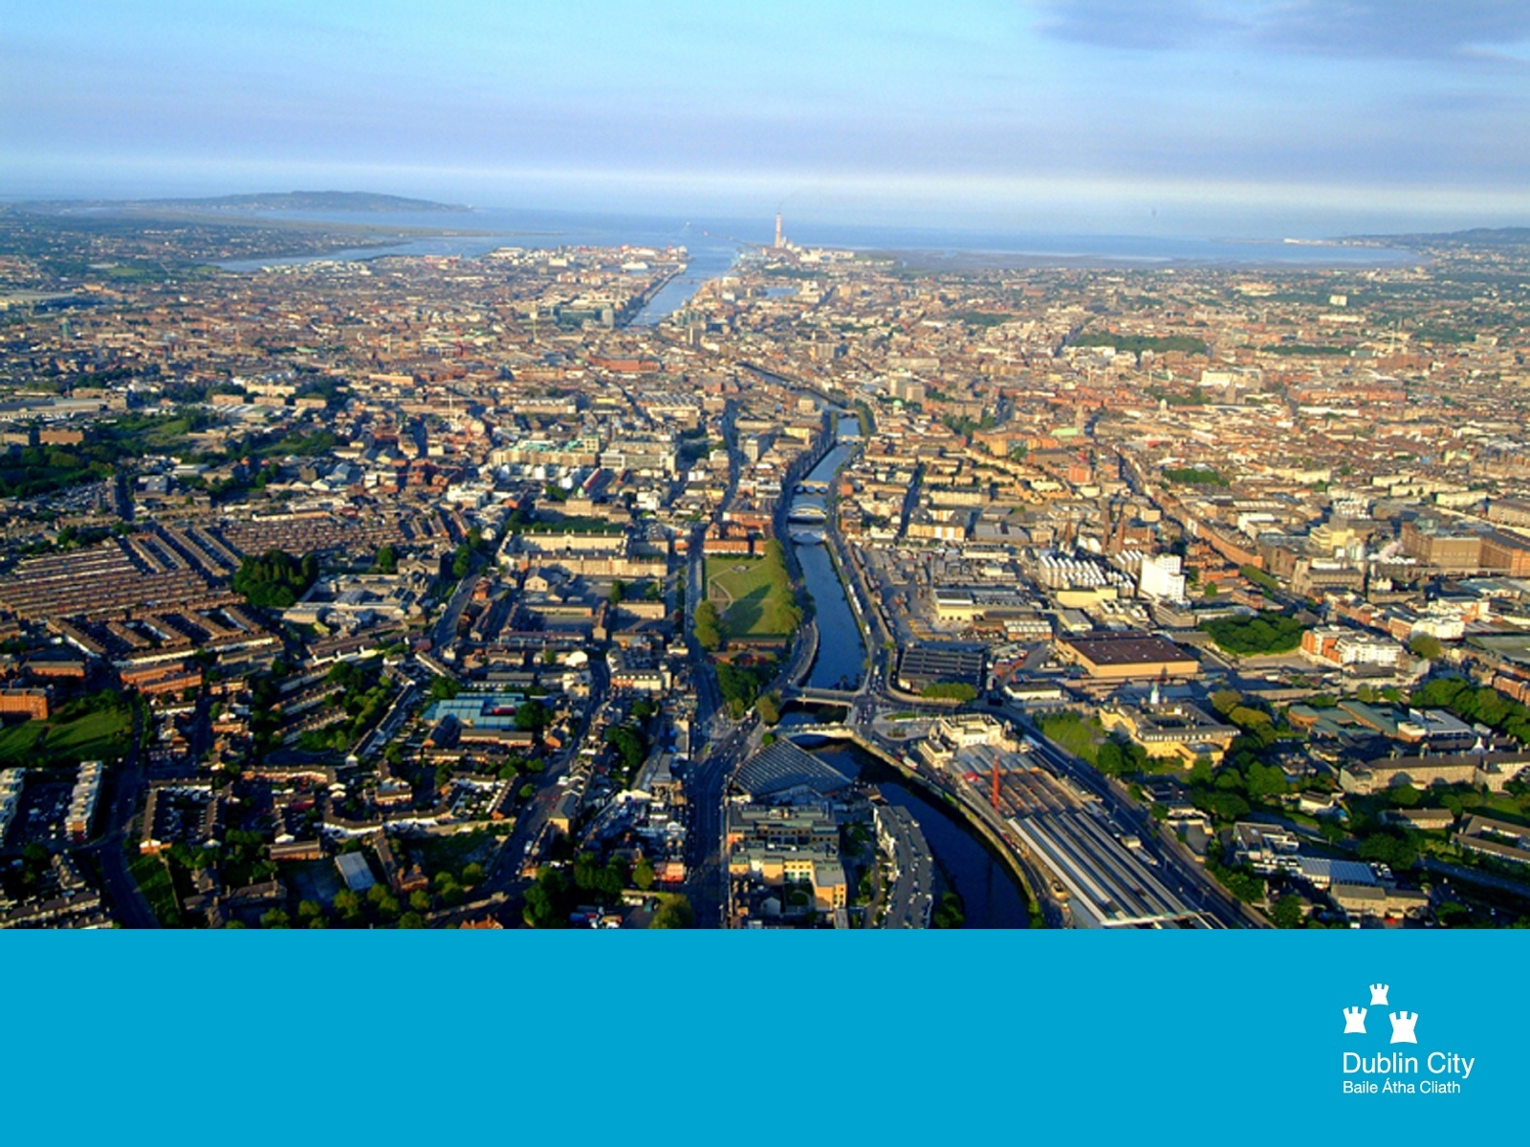
1
Dublin Bus Update 2015

Slide 2
Dublin Bus Overview 2015
918 Fleet (excluding Tour buses)
845 standard double deck
70 tri-axle double deck
3 midi buses
111 routes
7,300 weekday timetabled trips
52 million vehicle km operated per annum
2,500 drivers – we are actively recruiting 100 new drivers in 2015
3,300 total staff
7 depots
118 million customers
5,000 bus stops

Slide 3
Network Direct Objectives
Simplify the route network
Match supply with demand
Increase cross city services
Improve multi modal integration
Largest bus network restructuring in Europe- completed
Redesign of all 171 bus routes
36% reduction in route numbers therefore much simpler network
Network coverage maintained
+400 meetings with external stakeholders
Complete redesign of operational practices for all employees
Easier to market and explain

Slide 4
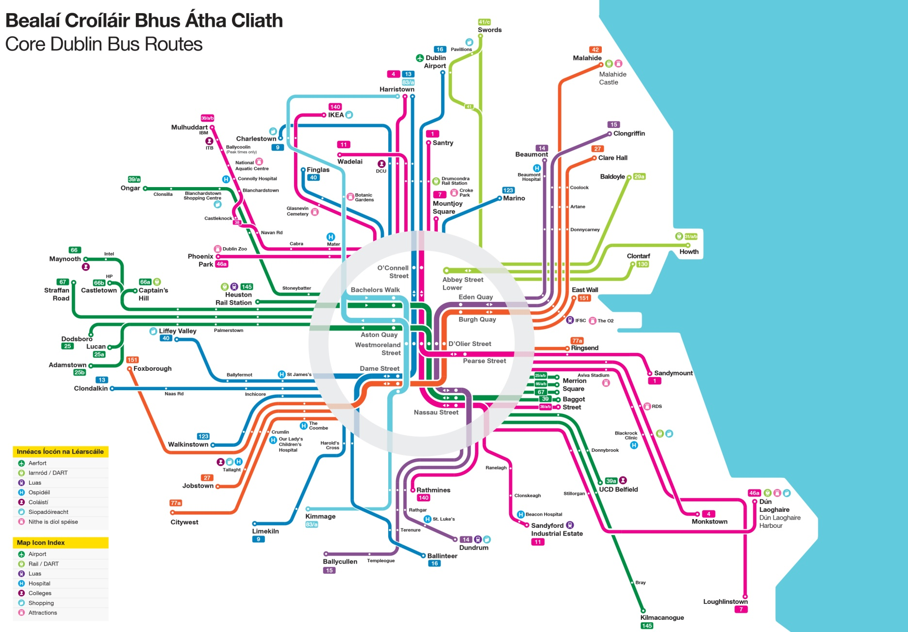

Slide 5
Network Direct Outcome
 | 2009 | Project End | Change
Routes | 171 | 111 | -36%
Fleet | 1,117 | 875 | -20%
Staff Customers Financial | 3,891 | 3,200 | -17% +3%pa €45M pa saving

Slide 6
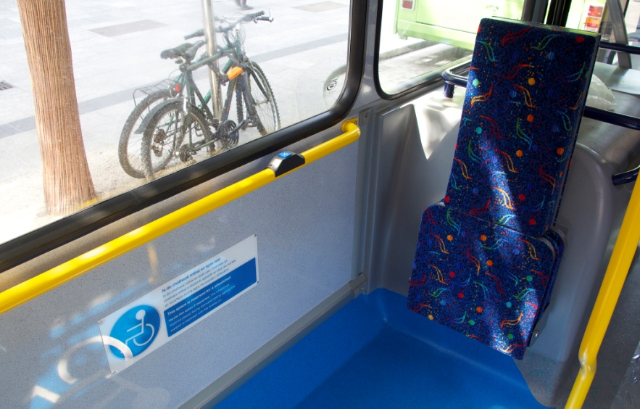
Customer Experience
100% accessible fleet – standard facilities on all routes and buses - continue addition of buggy space on new buses
Highest standard of training - vigil vanguard - for customer comfort and safety – for all drivers
Increased focus on customer contact training for drivers

Slide 7
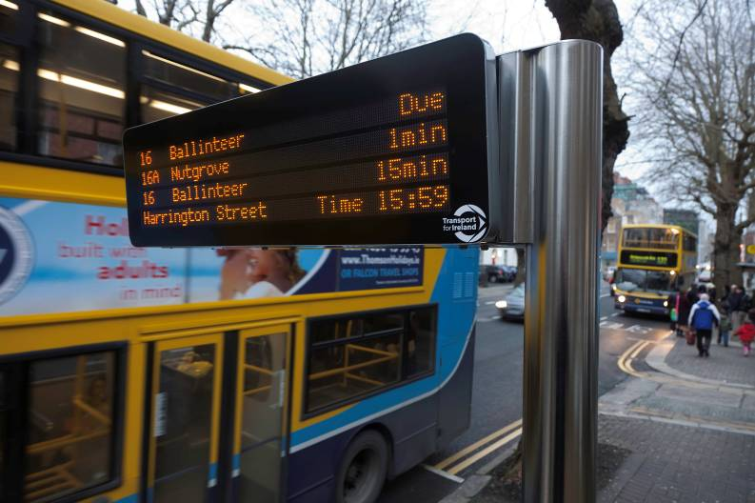
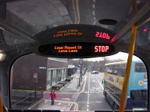
Customer Experience
Real Time Passenger Information on-street units at ~ 500 bus stops now – expanded list to NTA for further 400
Real time information available at all 5000 stops on Apps, Web and Txt.
800,000 app downloads across iphone/android
Customer Relationship Database building has commenced through Wi-Fi & web to develop outbound route specific alerts, allowing real time updates about changes to your route
Audio announcements - next stop and safety - on all buses
Passenger Information Displays On-Bus – Rolling out across the fleet during 2014 – 2015

Slide 8
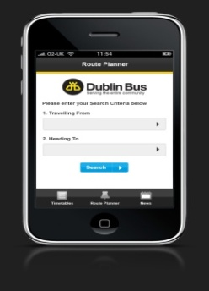
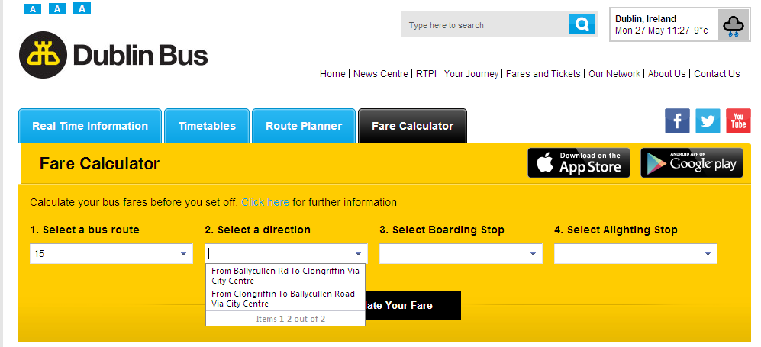
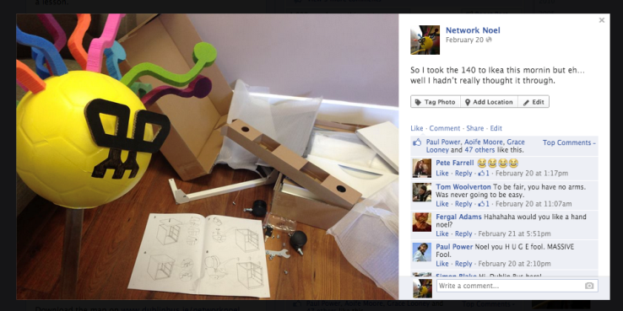
Customer Experience
WIFI – free and working well – available on all buses and routes now
Extensive use of on-line channels to communicate with customers. Both customer support & outbound marketing/information:
Ave. 400,000 site visits per month
16,000+ followers on Facebook, 24,000+ on Twitter
We are using all media channels to drive customers online to ‘relearn’ the new Network (Network Noel) in a fun and engaging way
We are working closely with the NTA to improve customer information – mapping, timetables, on-line information via the National Journey Planner - across the GDA

Slide 9
Leap and Fares
Full LEAP implementation from end 2014 to include:
Products – Dublin Bus rambler now purchased onto the Leap Card
Capping – limits on the cost of daily (6.90) and weekly (27.50) travel now apply – free journeys after a certain spend
Rebate - next journey within 90 minutes after start of first will be discounted
Autoload - Direct Debit arrangement to topup epurse automatically if credit falls below a certain point
Next step is to look at simplification of the DB cash fare range over three year period from 2014
Significant improvements in ease of using the networks and value for customers

Slide 10
Customer Experience
Research results From Behaviour and Attitudes survey in March/April 2014

Slide 11
Rejection of Dublin Bus – Longer Term Trend All Dubliners: 601
2007
2008
2009
2010
2011
2012
2014
Rejection of the brand is exceptionally low, FMCG rejection rates average 13%.
Q.4 | Which, if any, of these transport options would you never consider using?

Slide 12
Frequency of Using Dublin Bus – 2012 vs 2014 – Percentages & Thousands All Dubliners: 601
2012
2012
2014
2014
Base:
%
000s
Shifts:
Total users up 155k
Non-users down from 46% to 31%, 155k
Loyals up 54k
Non-users shifting into occasionals +106k
%
000s
Everyday
5 days a week
3/4 days a week
Twice a week
Weekly
Fortnightly
Monthly
Less often
Non User
Don’t know
Total users up to 600k, opportunity to grow usage among occasionals, strategy working to date
Q.8 | How often do you use _____________ PROBE FOR PRECODES FOR EACH USED

Slide 13
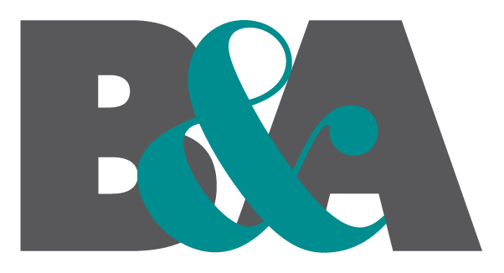
Satisfaction with Last Trip All ever use Dublin Bus: 408
Very satisfied
Fairly satisfied
Not very satisfied
Not at all satisfied
Strong score; crucially top box is greater than second box – positivity is quite emphatic. However: 70% - 80% top box is the norm in retail!
Q.12a | I would now like to ask you some questions about your most recent journey on Dublin Bus. Thinking about this journey, how satisfied were you with your experience overall?

Slide 14
Customer Numbers Growing
Growth of over 3% annually. This trend has now stabilised.
We carried an additional 4 million customers in 2014 – 118 million.
Build on strong performance of Network Direct /RTPI/Leap
Additional 10 buses in service November 2014 to service increased customer peak volumes
Additional 10 buses will be required from early 2015 to restore service level taking account of LCC diversions – Westland Row
Minimum of 50 additional buses will be needed in next 3 years
3 additional people employed for every bus added to the fleet

Slide 15
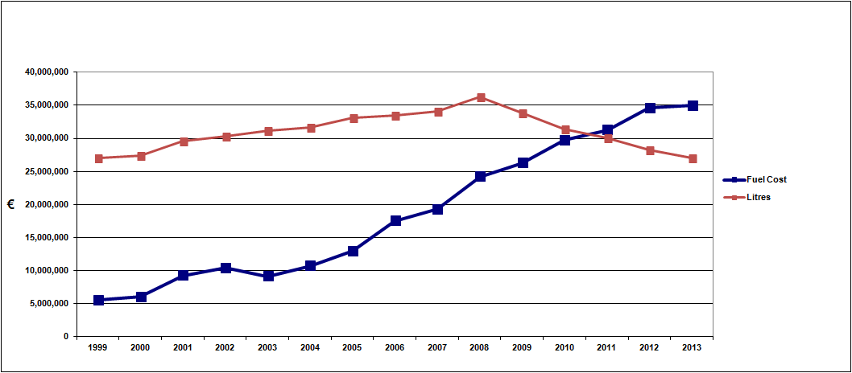
Dublin Bus Fuel Costs & Usage

Slide 16
Hybrid Diesel Electric Buses
Hybrid drive buses combine an electric motor with an internal combustion engine - typically diesel
Features
Smaller engines running in optimum range
Regenerative braking – recovery of electrical energy
Large capacity storage batteries
Good fuel efficiency – savings of 30%
Low CO₂ emissions and reduction in other pollutants
Driving experience similar to diesel bus
Only diesel fuel is required, therefore no change to the current fuelling infrastructure
Need to commence trialling these – 15 buses - €2.5M annual lease costs – business case currently being developed

Slide 17
Going Forward
Service growth to meet rising customer demand is essential and must be supported
Continue to raise the standard of Customer Service Experience
City Centre must be equally as accessible from all corridors in the city – be careful about moving bus services to more remote streets – working with all relevant authourities i.e. Co Co’s, NTA, Luas, Gardai

