Slide 1
FAI Presentation
To
South Dublin County Council
Monday 11th November 2013

Slide 2
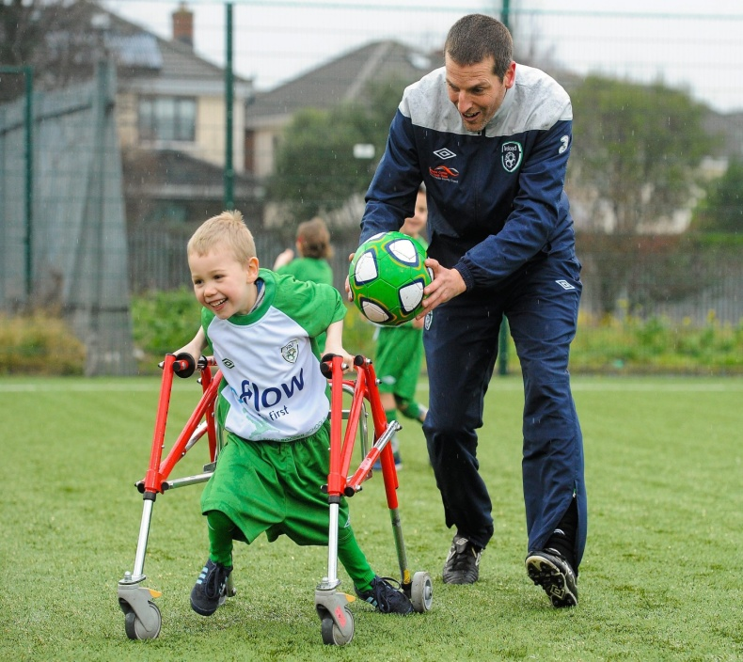
Development Officers in South Dublin County
Jim Crawford
JJ Glynn
Robert Hoey
Stephen Rice

Slide 4
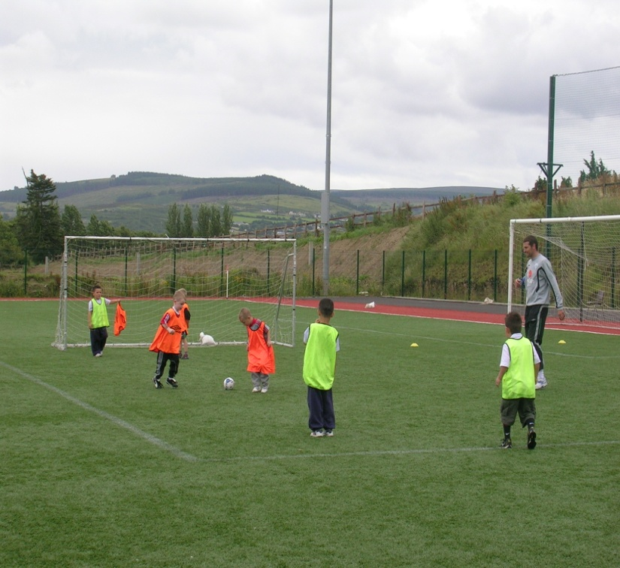
COMMUNITY CLUBS
Sacred Heart FC.
Coach Education
Football Nurseries
SDCC/FAI Relationship
Club Open Day
Girls Easter Blitz
Learning Difficulty Squad sessions
Unemployment League
Post Primary Futsal Competition

Slide 5
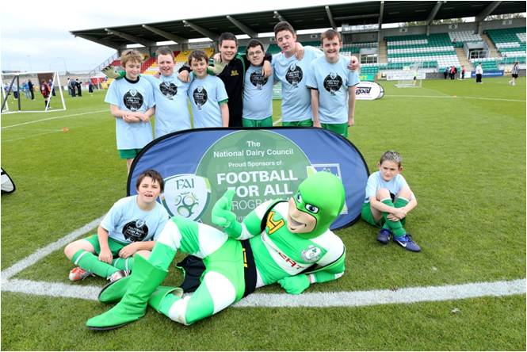
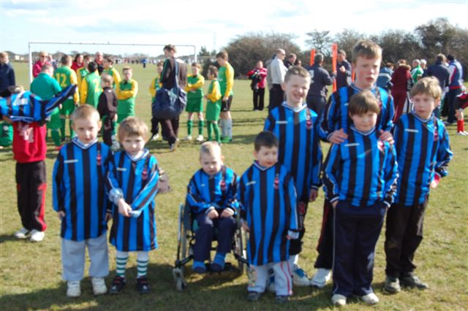
SACRED HEART FC
Football for All
Growth
National Blitz Days

Slide 6
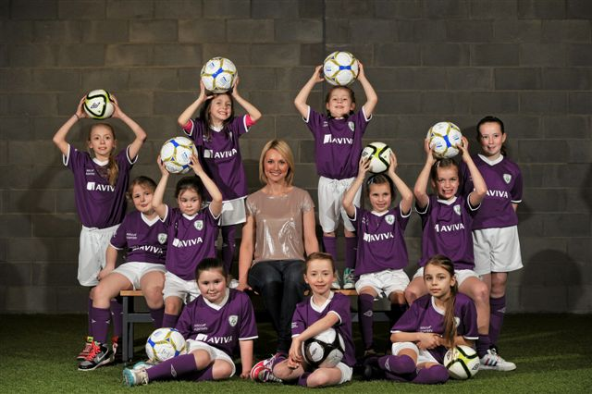
SOCCER SISTERS
Creating pathways for young girls in the community to play soccer
Interaction with clubs to begin girls teams
Taster coaching sessions in local schools
8 week after school coaching sessions
4 programmes currently running in South Dublin County -- Lucan/Clondalkin/Tallaght and Terenure
This is a Challenging area but we continue to try create sustainability in girls soccer in the county

Slide 7
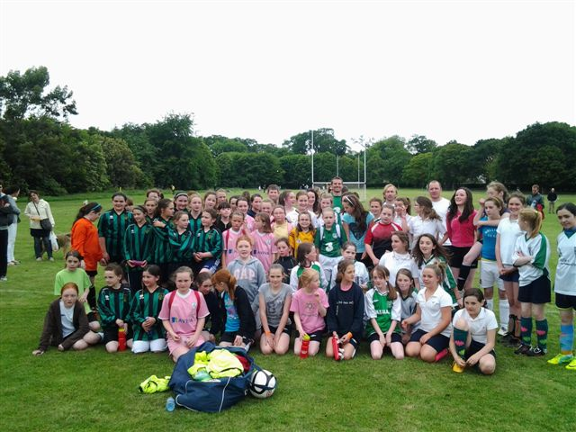

Slide 8
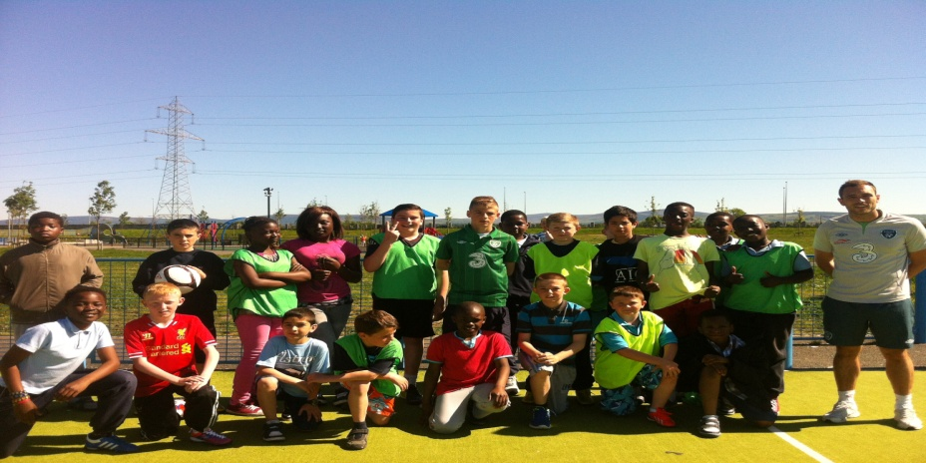
BALGADDY
Hugely diverse area in South Dublin County
Anti social issues/crime and racist attacks
Community Football Day; summer soccer kits/bags/tickets to Aviva
Kids Soccer Drop In’s every Tuesday
Soccer for unemployed adults every Thursday morning

Slide 9
FOOTBALL FOR ALL CHEEVERSTOWN
Group of 18 wheelchair users with a physical and or intellectual disability.
Programme running since 2008.
Sessions run Friday’s from September to June.
1.5 hour session which is assisted by 5th/6th class students who play fun football games.
10 primary schools involved for a 3 week block.

Slide 10
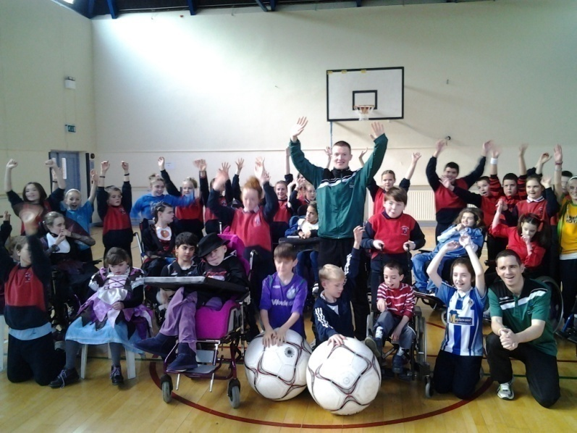
FOOTBALL FOR ALL CHEEVERSTOWN
‘It’s a win – win programme for every student involved with or without a disability.’ – Adrian Dunne Principal of Cheeverstown

Slide 11
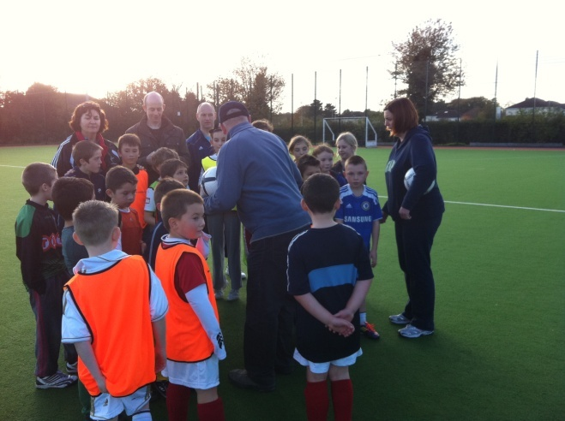
PROJECT FUTSAL (HUB) 2012/2013 Community Activity – the multiplier effect
One Development officer now coordinates activities of a TEAM of Interns and students (25)
Multiple social inclusion events delivered locally – often at same time!
Creating a sustainable base of volunteers going forward

Slide 12
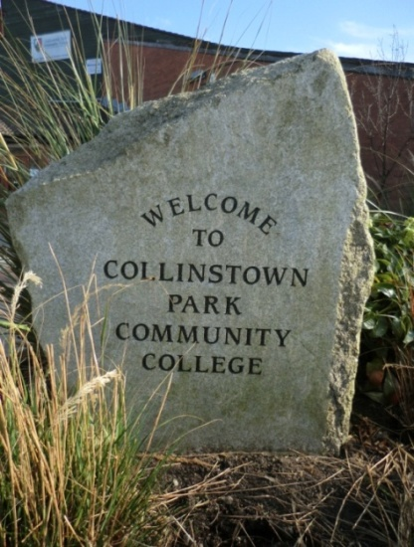
PROJECT FUTSAL (HUB) 2013/2014
35 people engaged with course so far...
1250 community hours completed last year
5 graduates secured Internships in FAI
56 applications this term – 27 accepted
Community work increasing time year
Number of programmes increased: Schools ,Late Night League, Soccer Sisters X 3
Football for All Programme
Researchers currently collating data on all participants

Slide 13
THANK YOU

